Slide 1

Welcome
Boot camp

Slide 2

ScienceLogic Bootcamp Training Team
Terri Armstrong
tarmstrong@sciencelogic.com
512.745.6717
Ron Burch
rburch@sciencelogic.com
571.572.2707

Slide 3


ScienceLogic Bootcamp Course
Goal:
Provide an environment where students develop advanced skills necessary to use, customize, administer, and troubleshoot the EM7 product.
Means:
Hands-on lab exercises for the ScienceLogic Platform
Labs build on the results of previous labs
Resource material for each feature provided at the end of the module covered
Hands-on Lab Icon references where the student is required to perform action(s)

Slide 4

Training Systems
Internal System Name | External System Name
student01 | student01.sciencelogic.com
student02 | student02.sciencelogic.com
student03 | student03.sciencelogic.com
student04 | student04.sciencelogic.com
student05 | student05.sciencelogic.com
student06 | student06.sciencelogic.com
student07 | student07.sciencelogic.com
student08 | student08.sciencelogic.com
Internal System Name | External System Name
student09 | student09.sciencelogic.com
student10 | student10.sciencelogic.com
student11 | student11.sciencelogic.com
student12 | student12.sciencelogic.com
student13 | student13.sciencelogic.com
student14 | student14.sciencelogic.com
student15 | student15.sciencelogic.com
student16 | student16.sciencelogic.com
Login: student Password: em7student

Slide 5

Boot Camp Agenda
MONDAY: DAY 1
June
Sciencelogic Overview
Architecture
Add/Remove Devices
Device Administration
Device Monitors
Device templates
Device Groups
15

Slide 6
Boot Camp Agenda
TUESDAY: DAY 2
June
Traps & Syslogs
Assets
Views
Event Console
Ticket Console
Reports
Runbook
Dashboards
16

Slide 7
Boot Camp Agenda
WEDNESDAY: DAY 3
June
Customization
Account Administration
Asset Administration
Event Administration
17

Slide 8
Boot Camp Agenda
THURSDAY: DAY 4
June
Device Global Settings
Ticket Administration
Dynamic Applications
18

Slide 9
Boot Camp Agenda
FRIDAY: DAY 5
June
Snippets & Runbook
API’s
Snippet Development
Platform
19

Slide 10
Day 1 Agenda
Topic | Topic Description | Estimated time
EM7 Intro | Overview of Sciencelogic Platform | 9am - 9:15
ScienceLogic architectures | Appliances Architectures supported | 9:15 – 10:15
BREAK |  | 10:15 – 10:30
Adding and removing devices | Credentials Organizations / Customization Users / hooks / Keys / vendors / external contacts Discovery | 10:30 – 12:00
LUNCH |  | 12:00 – 1:00
Device Administration | Device Reports Panel (Graph) Tabs Device Administration Panel (Wrench) tabs Global Views of devices | 1:00 – 2:00
Device monitors | Domain Name Email Round-Trip SOAP/XML Transaction SSL Certificates System Process TCP/IP Port Web Content Windows Service | 2:00 – 2:30
BREAK |  | 2:30 – 2:45
Templates | Create/Apply device templates | 2:45 – 3:20
Device Groups | Create/Rules/Uses | 3:20 – 4:00

Slide 11

Founded 2003
69% year over year growth
HQ in Virginia
Sales offices – London, Sydney, Singapore
120 Employees
Support:
Create a ticket by email:
support@sciencelogic.com
Enter a ticket directly:
https://portal.sciencelogic.com
Call 800-SCI-LOGIC (800-724-5644)

Slide 12





















The Ultimate Monitoring Platform
Assets
Automation
Reporting
Performance
Customer Portal
Events
Service Levels
Instant Management
CRM
Orchestration
Billing
Integrated Datastore
REST API
Service Desk
3rd
Party
Provisioning
Intelligent Discovery & Monitoring
Application
AWS - Cloud
Virtualization
Network
Compute
Storage
Physical
Notes:
This is how it works…Explain the details….
We use 15 different types of protocols, such as SNMP, XML, WMI and so on to collect information from lots of IT resources. We communcate with 3rd party products via a number of APIs, and what comes out of it are complete asset inventory, reporting, performance, eventing and more, including automation to correct problems on the fly. Non one else provide this level of coverage.

Slide 13




















































Leaders Choose Leaders
Service Providers
Enterprises
Government
Notes:
Over 15,000 organizations relies on ScienceLogic data. Today we have a healthy set of customers in Service providers that use our technology to increase IT effeciency and generate new sources of revenue, and theyinclude hosters, IaaS providers, MSPs, and even video providers. Large and complex networks in the enterprise use us to increase business uptime and resolve problems faster than ever. In the government where we are listed as the ONLY vendor in the JITC / DISA approved product list, for Network Infrastructure Monitoring, we are deployed in a large number of agencies. All in all customer buy from us, because they want to solve problems faster, increase efficiency, and generate revenue.

Slide 14

Architecture

Slide 15

Objectives:
Modules
Architectures
All-in-One
Distributed - Single Database
Distributed - Disaster Recovery
Distributed - High Availability
Distributed - High Availability + Disaster Recovery
Collector Groups
Data Collector(s) in Collector Groups
Message Collector(s) in Collector Groups
Architecture

Slide 16
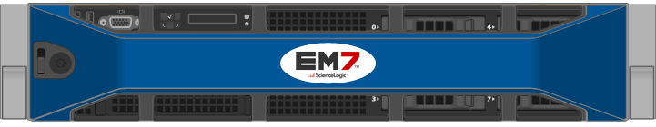
6 Module types (physical or virtual)
Module Type
Purpose
Performs all appliance type tasks (API, web, data & message collection and database)
All – In – One (AIO)
Database Server
Centralized Data Repository ( and email server)
Administration Portal
Provides Web-based User Interface
Polls managed devices for data. Can receive syslog and / or traps from Managed Devices (20 messages/second)
Data Collector
Message Collector
Receives syslog and traps from Managed Devices (200 messages/second)
Integration Server (RESTful API)
Provides access to data stored on the Database Server through an API
Architecture

Slide 17

EM7 is built on the LAMP Stack
L – Linux OS (CentOS)
A – Apache HTTP Server
M – MySQL Database
P – Python (backend), PHP (frontend)
Architecture

Slide 18
Architectures
All-In-One Architecture
All-In-One
All-In-One with Disaster Recovery
Distributed Architectures (Database + separate collector(s))
Single Database (1)
Databases (2) with High Availability
Databases (2) with Disaster Recovery
Databases (3) with High Availability + Disaster Recovery
All architectures are supported as virtual machines (supported hypervisors and scale limitations apply) or physical hardware.
Architecture

Slide 19
All-In-One Architecture
All-In-One Appliance performs all functions
Administration Portal
Database
Data Collector
Message Collector
Integration Server (API)
Architecture

Slide 20
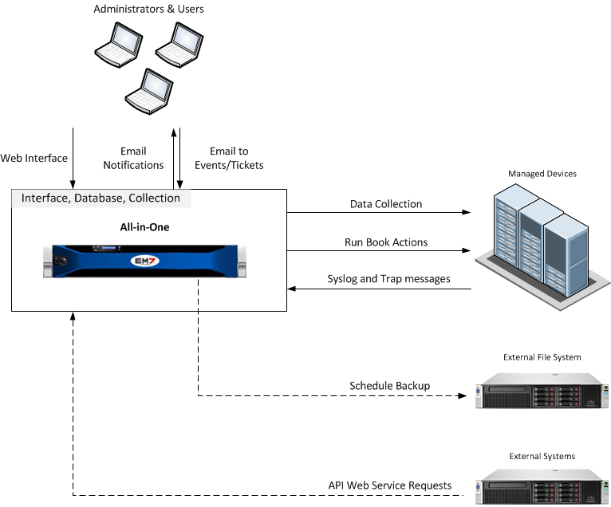
All-In-One Architecture
Architecture

Slide 21
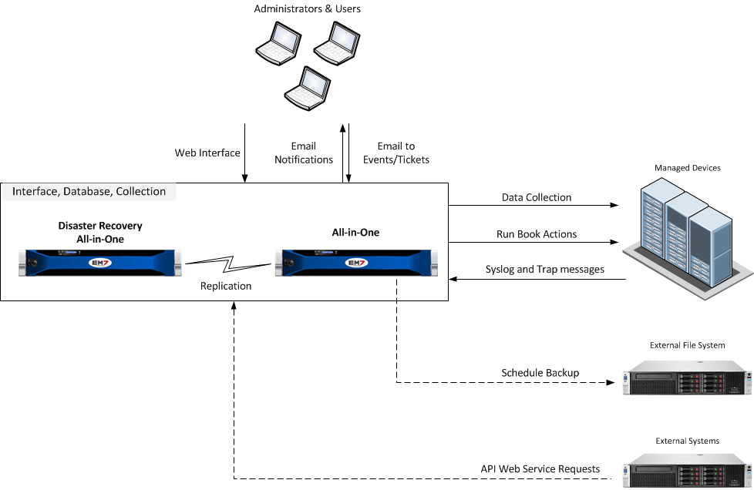
All-In-One Architecture with Disaster Recovery
Architecture

Slide 22
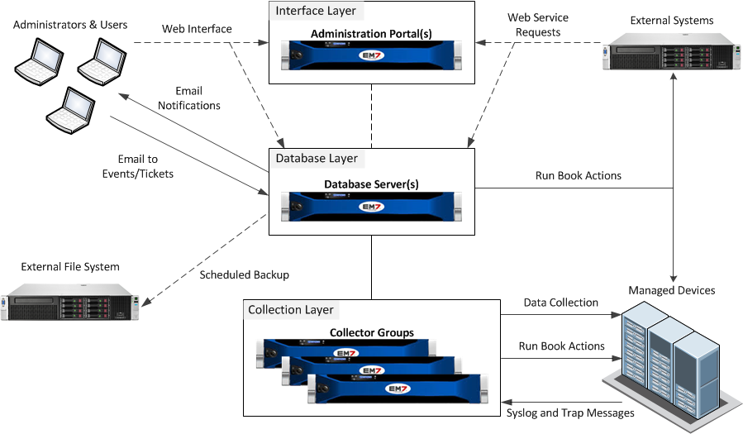
Distributed Architecture
In a Distributed system, the functions of EM7 are divided between multiple appliances. The smallest Distributed system has two appliances:
A Database appliance that provides the user interface (Administration Portal) and performs all database functions (Database).
A Data Collector that performs data and message collection.
Architecture

Slide 23
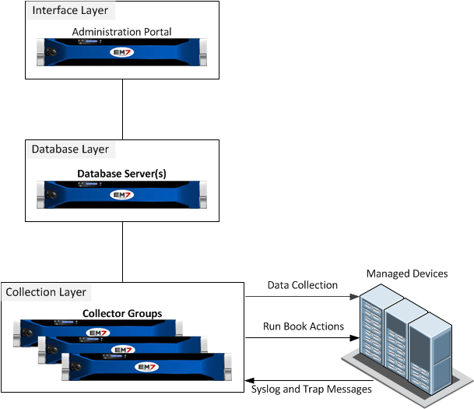
Distributed - Single Database
Architecture

Slide 24
Multi-Database
High Availability
Single site
Hardware redundancy (if built on physical servers)
Automatic failover process
Active/Passive
Disaster Recovery
Single or Multi-site
Real time replication
Manual failover process
Active/Passive
High Availability + Disaster Recovery
Designed for High Availability (HA) at the Primary Site with Disaster Recovery (DR) replication to the Secondary Site.
Architecture

Slide 25
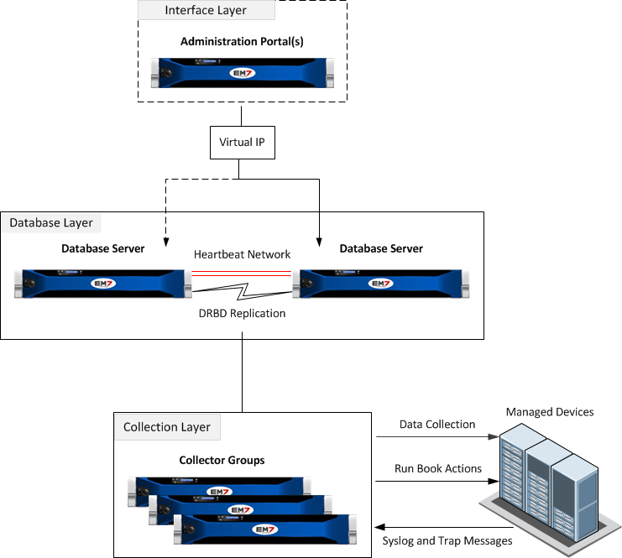
Distributed - High Availability
Single site
Hardware redundancy if using physical servers
Automatic failover using a Heartbeat network
Active/Passive – only one of the Database servers is active at a time
Architecture

Slide 26

Distributed - Disaster Recovery
Single site or Multi-site
Real time replication
Identically sized file systems
Manual failover process
Architecture

Slide 27
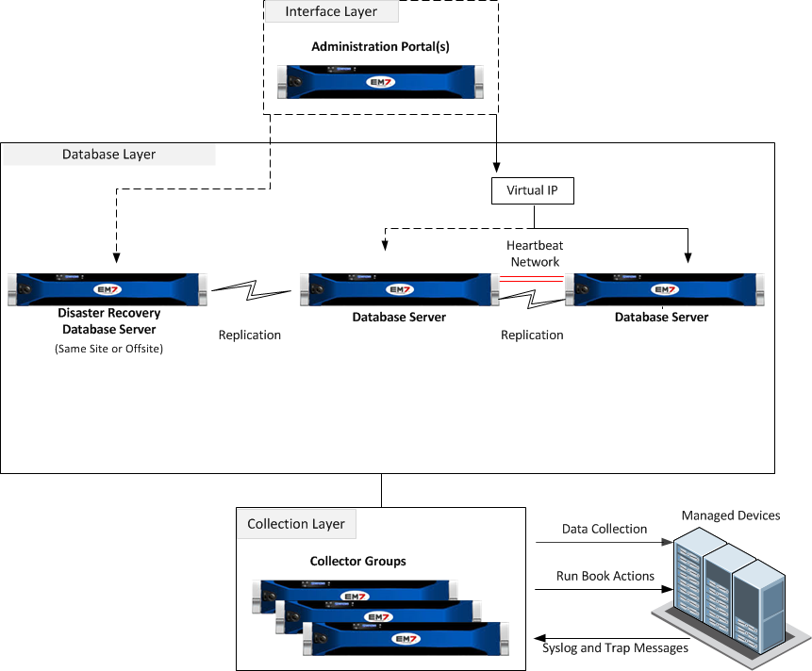
Distributed - High Availability + Disaster Recovery (HA + DR)
Designed for High Availability (HA) at the Primary Site with Disaster Recovery (DR) replication to the Secondary Site.
Architecture

Slide 28
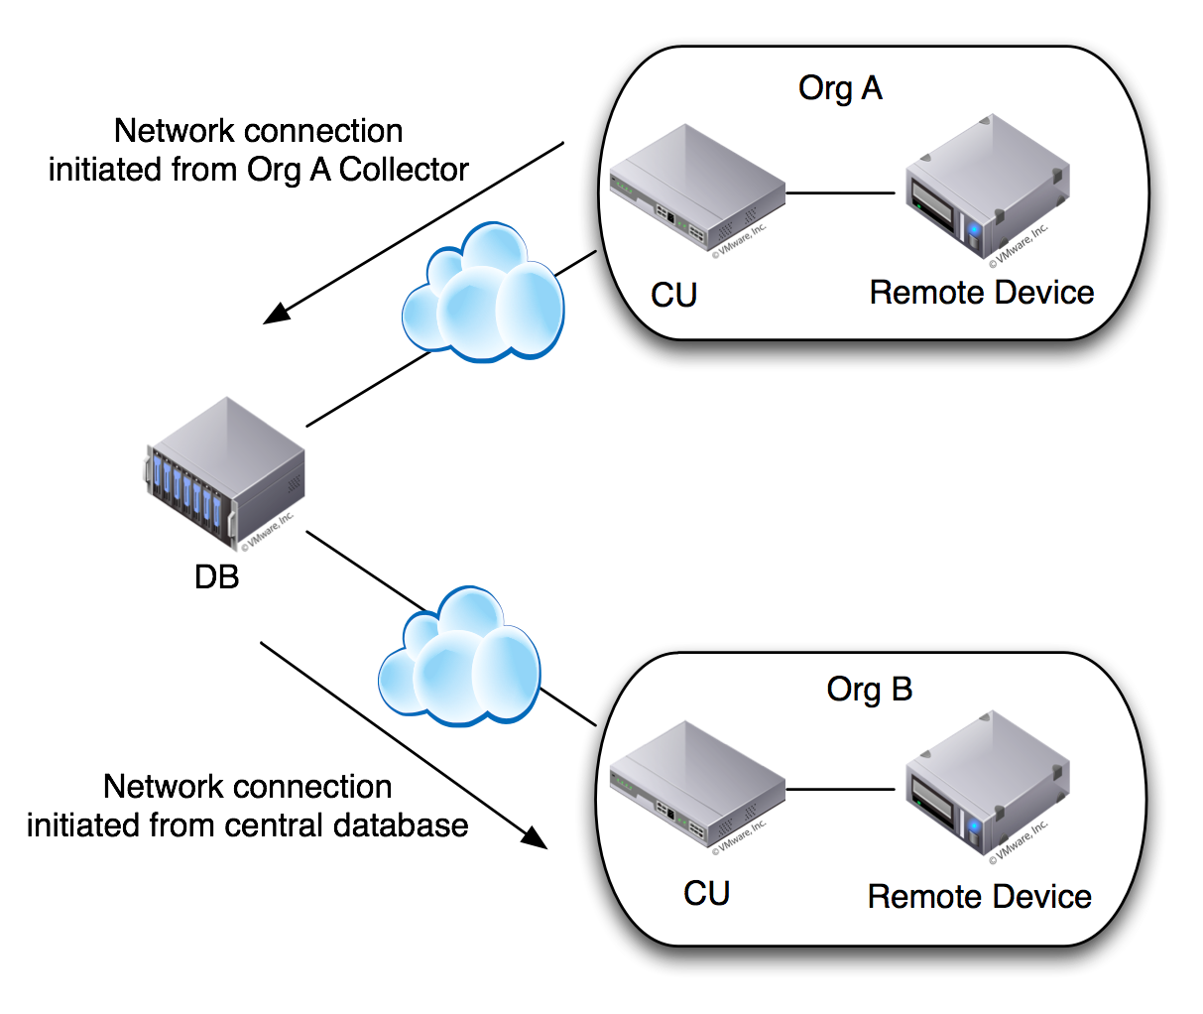
Data Collector Communication
Native Collectors: Only support connectivity initiated by the central
database to remote collectors, whether for the purpose of pushing configuration to the collectors or pulling data back from them.
Phone Home Collectors: Initiates from the collector to the database over SSH connection port 22.
Reduce deployment time and effort by eliminating the need for firewall changes at the remote site, while seeing no increase in risk to central database or to other customers.

Slide 29
Communication Ports
Depending on your architecture, there are specific ports that must be open for communication. RSA 2048 encryption is used for communication between the database and collectors (data collectors & message collectors)
Source | Destination | Port
Database | Data Collector | TCP 7707
Database | Message Collector | TCP 7707
Administration Portal | Database | TCP 7706
Integration Server | Database | TCP 7706
User Access | API Web Service | TCP 443
User Access | Administration Portal | TCP 80 or TCP 443
Data Collector | SNMP Managed Device | ICMP and UDP 161
Managed Device | Data/Message Collector | UDP 162 (Traps), UDP 514 (Syslog)
Data Collector | Database | TCP 22 (SSH, Phone Home Collector)
Architecture

Slide 30
Collector Groups
In a Distributed EM7 system, the Data Collectors and Message Collectors are grouped into Collector Groups. Grouping multiple Data Collectors allows you to:
Load-balanced Collection: collector with the lightest load handles newly discovered device.
Redundant Collection: if a Data Collector fails, another Data Collector is available to handle collection until the problem is solved.
Note that:
All Data & Message Collectors must belong to a Collector Group.
Each monitored device is aligned with a Collector Group.
Managed devices are balanced across the Data Collectors in a Collector Group.
Collector Groups can be configured for either:
Redundancy – load is redistributed to remaining collectors in the collector group
Maximum Capacity – there are no redundancy features for this setting
Architecture

Slide 31
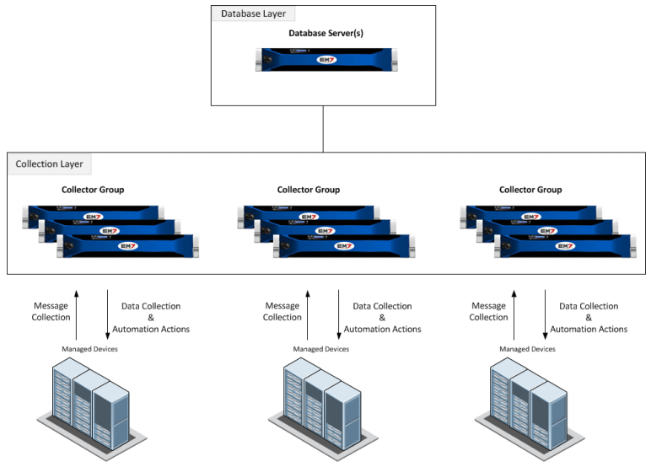
Data Collectors in Collector Groups
Architecture

Slide 32
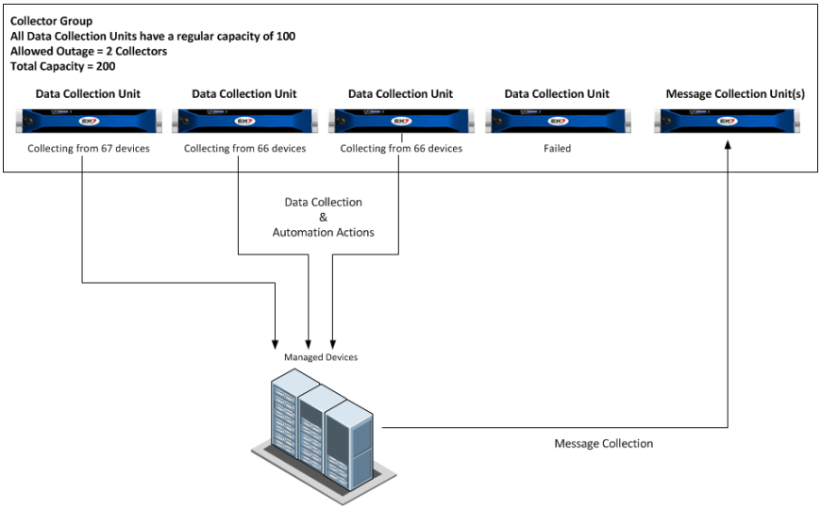

EXAMPLE: 1 Collector Fails
Total monitoring load was 200 devices between 4 collectors. With the failure of one collector the load has been redistributed.
Architecture
Notes:
When all Data Collection Units are available, ScienceLogic evenly distributes the devices monitored by a collector group among the Data Collection Units in the Collector Group. In this example, there are 200 devices monitored by the Collector Group, with each of the four Data Collection Units responsible for collecting data from 50 devices.
If one of the Data Collection Units in the example Collector Group fails, the 50 devices that Data Collection Unit was monitoring are redistributed evenly between the other three Data Collection Units

Slide 33
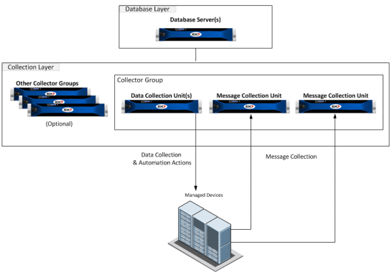
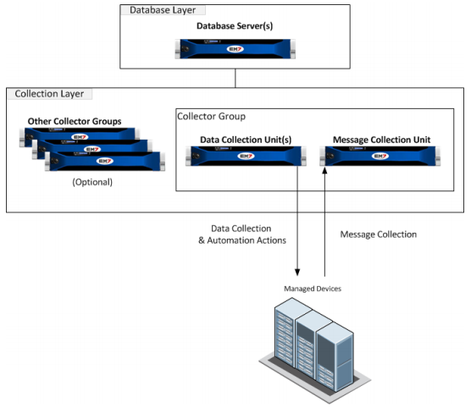
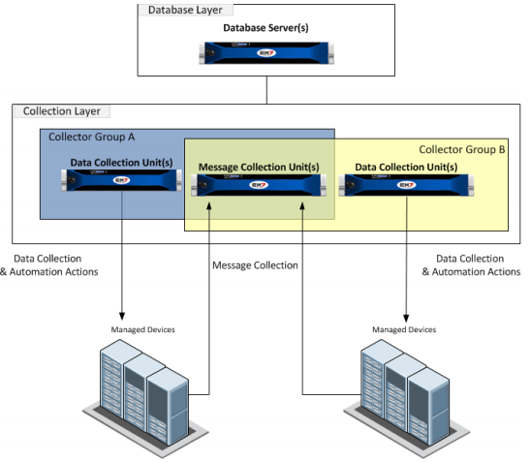
Message Collector(s) in Collector Groups
A Message Collector must belong to at least one Collector Group
A Message Collector can belong to multiple Collector Groups
Multiple Message Collectors can belong to a single Collector Group
Note that if you are using a Data Collector for both data collection and message collection, then it must be in a single collector Collector Group.
Single Message Collector in CUG
Single Message Collector
in Multiple CUG’s
Multiple Message Collectors in CUG
Architecture

Slide 34


Resources And Questions
For more information:
Architecture manual
Guide Button
All manuals are available on the Customer Portal:
http://portal.sciencelogic.com
Add/Remove Devices

Slide 35

Add/Remove Devices

Slide 36
Day 2 Objectives
Credentials
Creating Credentials
Organizations Overview
What is Discovery?
How does Discovery work?
Create and Execute a Discovery Session
Discovery Session Logs
Discovery Log Messages
Scheduling a Discovery Session
Re-discovery of an existing device
Deleting Discovery Sessions
Deleting Devices
Add/Remove Devices

Slide 37
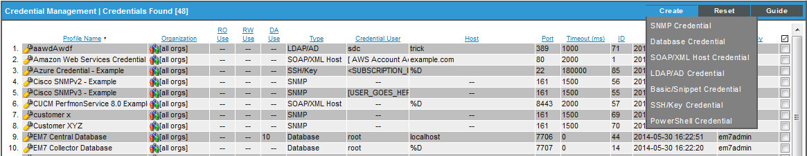
Credential Management
System > Manage > Credentials
Credentials are access profiles (usually username, password, and any additional information required for access) that allow EM7 to retrieve information from devices and from software applications on devices.
With SNMP the password is called a “Community String”
Add/Remove Devices
Notes:
The Credential Management page displays a list of all credentials in ScienceLogic. For each credential, the page displays:
Profile Name. Name of the credential.
R+/W+ Use. For SNMP credentials, specifies whether the credential is for read-only access or if it also includes write access.
DA Use. Specifies the number of Management Templates aligned with this credential.
Port. Port used by the credential to communicate with the external device or application.
Type. Type of credential. Possible types are SNMP, Database, SOAP/XML, LDAP/AD, and Basic/Snippet .
Credential User User name associated with the credential.
Host. Host name or IP address that ScienceLogic will use the credential to communicate with.
Timeout. Time, in milliseconds, after which ScienceLogic will stop trying to communicate with the external device or application.
ID. Unique numeric ID, automatically assigned by ScienceLogic to each credential.
Last Edited. Date the time the credential was created or last edited.
Edited By. ScienceLogic user who created or last edited the credential.

Slide 38

7 Types of Credentials
SNMP – versions 1, 2, and 3
Database – used to connect to a database
SOAP/XML – used for web service transactions
LDAP/AD – used for account authentication
Basic/Snippet – used for basic username/password type authentication (ie. Backups, WMI, PowerShell, EMC, NetApp)
SSH/Key Credential
PowerShell
Add/Remove Devices

Slide 39
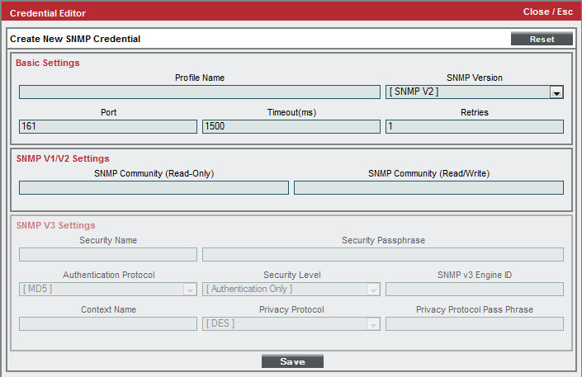
Creating an SNMP Credential
System > Manage > Credentials > Create > SNMP Credential
Community string
SNMP uses the term “Community String” for the function of a password.
Add/Remove Devices
Notes:
SNMP Credentials (previously called "community strings" in earlier versions of SNMP) allow ScienceLogic to access SNMP data on a managed device. The Credential Editor page displays the following for SNMP Credentials.
To edit a SNMP credential, select the wrench icon from the Credential Manager page and edit the values in one or more fields.
Basic Settings
Profile Name. Name of the profile. Can be any combination of alphanumeric characters.
SNMP Version. SNMP version. Choices are SNMP V1, SNMP V2, and SNMP V3.
Port. Port ScienceLogic will use to communicate with the external device or application.
Timeout (ms). Time, in milliseconds, after which ScienceLogic will stop trying to communicate with the SNMP device.
Retries. Number of times ScienceLogic will try to authenticate and communicate with the external device.
SNMP V1/V2 Settings
These fields appear if you selected SNMP V1 or SNMP V1 in the SNMP Version field. Otherwise, these fields are grayed out.
SNMP Community (Read Only). The SNMP community string (password) required for read-only access of SNMP data on the remote device or application.
SNMP Community (Read/Write). The SNMP community string (password) required for read and write access of SNMP data on the remote device or application.
SNMP V3 Settings
Security Name. Name used for SNMP authentication.
Security Passphrase. Password used to authenticate the credential
Authentication Protocol. Select an authentication algorithm for the credential. Choices are MD5 or SHA.
Security Level Specifies the combination of security features for the credentials. Choices are: Security Level No Authentication / No Encryption
Authentication Only, Authentication and Encryption
SNMP v3 Engine ID. The unique engine ID for the SNMP agent you want to communicate with. (SNMPv3 authentication and encryption keys are generated based on the associated passwords and the engine ID.)
Context Name. A context is a mechanism within SNMPv3 (and AgentX) that allows you to use parallel versions of the same MIB objects. For example, one version of a MIB might be associated with SNMP Version 2 and another version of the same MIB might be associated with SNMP Version 3. For SNMP Version 3, specify the context name in this field.
Privacy Protocol. The privacy service encryption and decryption algorithm. Choices are DES or AES.
Privacy Protocol Pass phrase. Privacy password for the credential.

Slide 40

Organizations
Organizations can be thought of as a container that hold elements in ScienceLogic. Elements (below) are associated with an Organization and only User Accounts that are aligned with an Organization will access elements from that Organization.
The Organization ID is called a “Record of Authority ID” or “roa_id”
Elements are referenced as “xtypes” in the database
Element | xtypes | Icon
Organization | 0
Device | 1
Asset | 2
IP Network | 3 | N/A
Interface | 4
Vendor | 5 | N/A
User Account | 6
Virtual Interface | 7 | N/A
Device Group | 8 | N/A
IT Service | 9
Ticket | 10
ORG
Account Administration

Slide 41
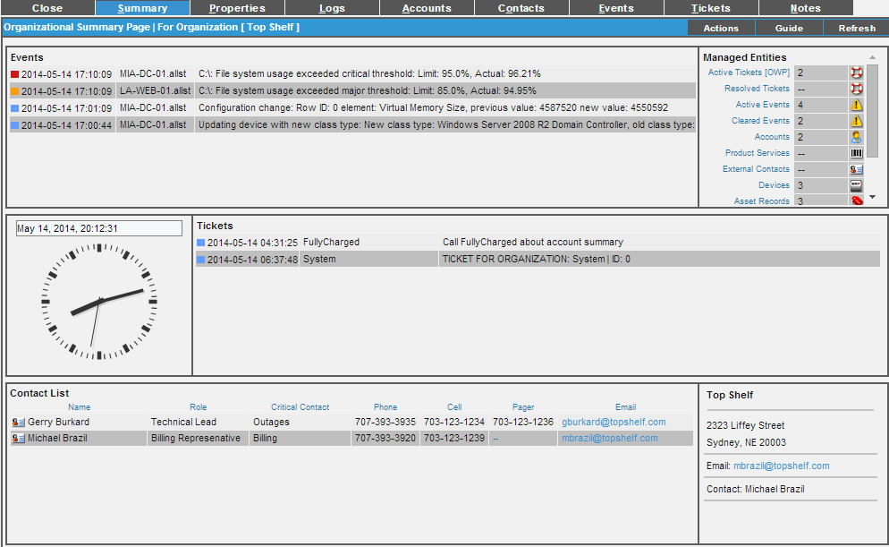
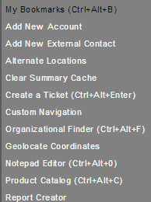
Organizations: Record
An Organization Record is a collection of information organized into the following tabs:
Summary – provides a view of recent Events, Tickets. In addition, there are accounts and the Org contact
Properties – basic information, critical contacts, product usage
Logs – Audit logs for this Organization (all audit logs can be seen at System>Monitor>Audit logs
Accounts, Contacts, Events, Tickets, and Notes
Organization [Actions] button:
Create tickets, accounts, contacts
Alternate Locations are equivalent to branch offices
Custom navigation creates a new tab that links to a URL
Account Administration

Slide 42
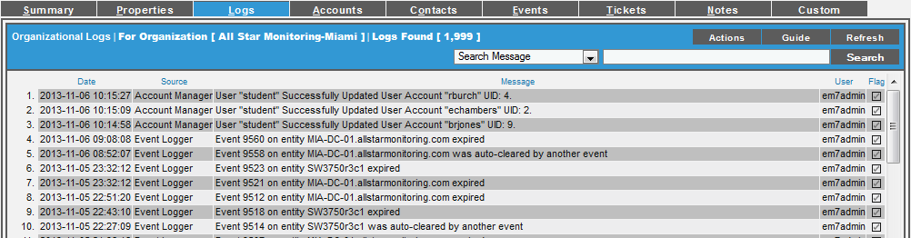
Organizations: Logs
Registry > Accounts > Organizations > Wrench an Org > Logs
Organization member creating, editing or deleting anything in ScienceLogic
All logins by Organization members
All notifications sent to Organization members
All events and tickets associated with an entity managed by the Organization
These are the logs for a single Organization, to view all Organization logs go to: System>Monitor>Audit Logs
Account Administration
Notes:
The Organizational Logs page displays a record of all actions pertaining to the Organization. These actions include:
All logins by Organization members
All notifications sent to Organization members
Organization member creating, editing or deleting anything in ScienceLogic
All events associated with an entity managed by the Organization
All tickets associated with an entity managed by the Organization
Actions (create, edit, delete) performed on elements or policies that are aligned with an organization instead of a device. The following ScienceLogic elements and policies are associated with an organization:
- user accounts
- user policies
- device templates
- ticket templates and scheduled tickets
- bandwidth-billing policies
- policies for monitoring RSS feeds
- automation policies and action policies
The Organization Logs page provides a complete audit trail for an Organization.

Slide 43
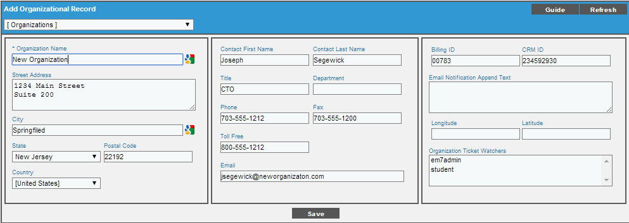
Organizations: Create
There are two ways of creating an Organization:
Registry > Accounts > Organization> Create
Organization Name in the only requirement, but as many fields as possible should be filled out.
These fields are shown on the Organization Registry page: Name, City, State, Contact, Phone, Email
API resource “/organization”
Account Administration

Slide 44
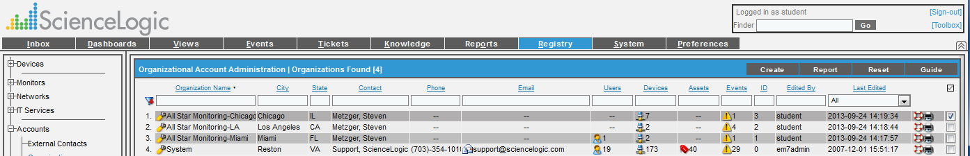
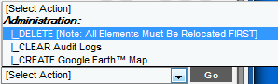
Organizations: Administration
Registry > Accounts > Organizations
At a glance view of Organization contact, phone, email, and the number of Users, Devices, Assets, and Events
Bulk actions are:
Delete
Create Google Earth Map (requires Google Earth installation and entry of Latitude and Longitude values in Organization record)
Clear audit logs
Account Administration

Slide 45
Organizations: System Org
Registry > Accounts > Organizations
The “System” Organization is a unique org:
System is the default Organization included in all ScienceLogic systems
Best Practice is to only have the system appliances systems in it
It is identified as “roa_id=0” in the database and cannot be deleted
Account Administration
Notes:
ScienceLogic automatically creates a default organization, called System. This organization has the ID number “0” (zero). The System organization has some behavior that differs from user-defined organizations.
If you do not specify an organization when creating a user account, the new account is assigned to the System organization.
If you do not specify an organization when performing dynamic-discovery, all devices (and their components), interfaces, and IP networks are assigned to the System organization.
You cannot delete the system organization.
You cannot bulk-edit the system organization.

Slide 46
Organizations: Delete
Registry > Accounts > Organizations
Before you can delete an Organization the following must be deleted or moved to another Organization. These are all of the elements (xtypes) except for organization.
User Accounts | IP Networks | IT Services
Assets | Device Groups | Vendors
Devices | Interfaces
Tickets | Virtual Interfaces
Account Administration
Notes:
ScienceLogic automatically creates a default organization, called System. This organization has the ID number “0” (zero). The System organization has some behavior that differs from user-defined organizations.
If you do not specify an organization when creating a user account, the new account is assigned to the System organization.
If you do not specify an organization when performing dynamic-discovery, all devices (and their components), interfaces, and IP networks are assigned to the System organization.
You cannot delete the system organization.
You cannot bulk-edit the system organization.

Slide 47
What is Discovery?
“Discovery” is the process of adding devices into EM7. There are two types:
Pingable Discovery (*must select Discover Non-SNMP option)
No Credential required
Provides availability, latency, and port monitoring
SNMP Discovery
Credential required, SNMP agent must be running on target device
Determines device vendor, model, OS, and version
Collects hardware configuration, file system, bandwidth, services, processes and installed software information
Discovers all network interfaces, including type, MAC address, speed, errors, discards and bound IP addresses
Automatically aligns dynamic applications based on discovery objects
Add/Remove Devices
Notes:
What is Dynamic Discovery?
Dynamic discovery simplifies the management of the management system by automatically gathering information on devices and components within the network. Through the dynamic discovery process, the appliance can identify more than 7,000+ unique devices types, device manufacturer, model number, network interfaces, including MAC address, speed and bound IP addresses, and determine OS type and version. It also determines if known collection agents are running and, if so, immediately begins collecting and trending performance. All this information is automatically added to the system. The system can even be configured a automatically apply monitoring policies to a type of device. For example, if a device is a web server the system can be configured to automatically monitor the availability of TCP port 80.

Slide 48
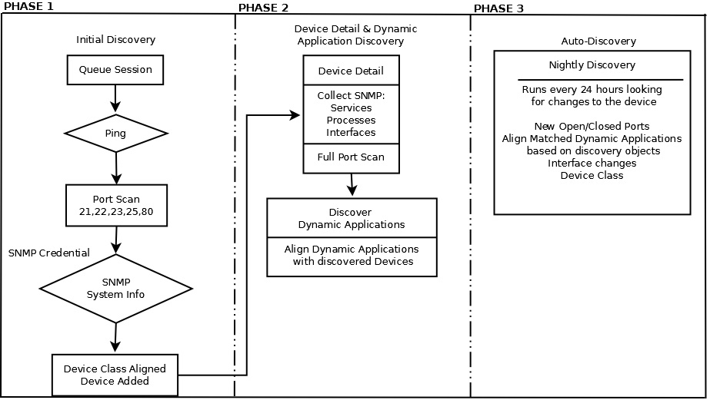
SNMP Discovery Process
(discover_iprange.py)
(discover_detail.py)
(discover_update.py)
Add/Remove Devices

Slide 49
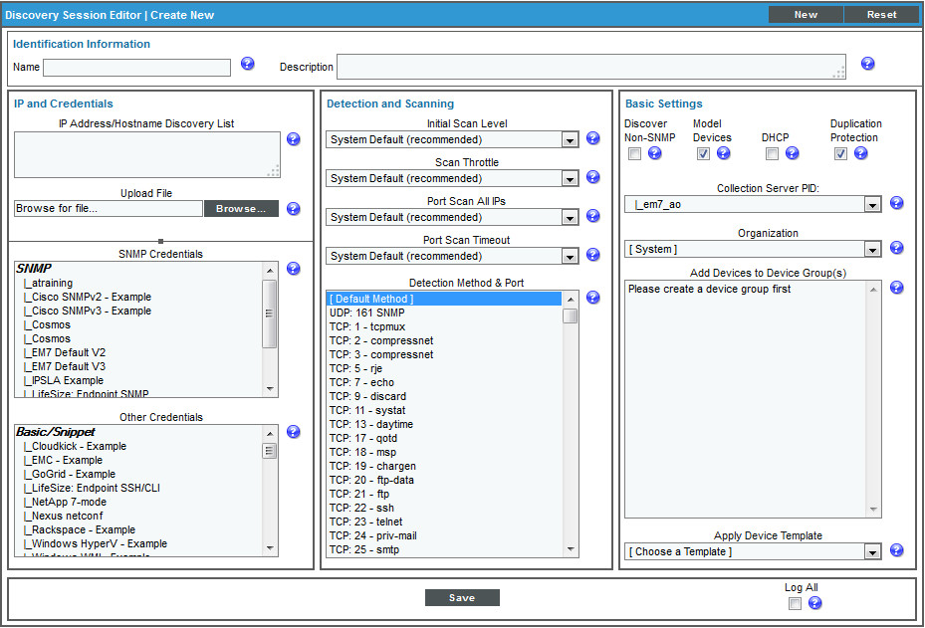
Create a Discovery Session
System > Manage > Discovery > Create
Check here for Ping only. Doesn’t require credentials
Run an IPv4 or IPv6 discovery in ranges or blocks. You also have the option of uploading a seed file
Select one or more SNMP Credentials
Set Collector and Organization
Check to see logs
Add/Remove Devices
Notes:
To perform discovery for one IP address or a range of IP addresses, perform the following steps;
Go to the Discovery Control Panel page (System > Manage > Discovery).
To create a new discovery session, select the Create button.
The Discovery Session Editor modal page appears.
In the Discovery Session Editor modal page, enter values in each field.
IP Address Discovery List. You must provide a list of IP addresses for ScienceLogic to scan during dynamic-discovery. In this field, you can enter a single IP address, a list of IP addresses separated by commas, the IP address for an entire network, and/or a range of IP addresses with a “-“ (dash) characters between the beginning of the range and the end of the range. Each IP address must be in standard IP notation and cannot exceed 15 characters. You can also include single addresses in IPv6 notation.
Organization. This field contains a list of all Organizations defined in ScienceLogic. Device discovered during the dynamic-discovery session will be assigned to the selected Organization.
NOTE: Make sure you have the desired organization created, and selected before running the discovery process. This field assigns all devices and networks in the specified IP range to a single organization. However, you can later assign individual devices and networks to different organizations.
Detection Method & Port. After dynamic-discovery, ScienceLogic will use this port (or group of ports) to determine if the range of devices is up and running. ScienceLogic then uses the results in availability reports for the devices. If you are not sure which ports are used by the range of devices, select the entry Default Method. ScienceLogic will check ICMP (ping), FTP, SSH, Telnet, SMTP, and HTTP ports.
Collection Server. This field contains a list of all ScienceLogic Data Collection servers on the network. Select the Data Collection server that is local or closest to the network to be discovered.
SNMP Credentials. A user-name and password pair (among other fields) that allows ScienceLogic to access a device's SNMP data. You can select one, ,multiple, or all SNMP credentials in this field. SNMP credentials are defined in the System > Manage > Credentials page.
Rediscovery. Specifies whether or not ScienceLogic should re-discover the entire IP range and if so, how frequently.
This feature is particularly useful for blocks of IP addresses using DHCP.
Other Credentials. A user-name and password pair (among other fields) that allows ScienceLogic to access database data, SOAP data, XML data or data that is monitored with a Snippet dynamic application. These credentials are defined in the System > Manage > Credentials page.
Discover Non-SNMP Devices. This field specifies whether or not ScienceLogic should discover devices that don't run SNMP.
o Selected. ScienceLogic will discover devices that don't run SNMP. Most likely, ScienceLogic will gather only limited data about the device. This option is useful when network security, like a firewall, limits ScienceLogic to ICMP communication with a device.
o Not selected. ScienceLogic will not discover devices that don't run SNMP.
Duplication Protection. Specifies whether or not a device should be discovered more than once.
o Selected. Tells ScienceLogic to skip dynamic-discovery for secondary IP addresses. If a device has two IP addresses, ScienceLogic will perform dynamic-discovery only for the primary IP address. This expedites the dynamic-discovery process, because it prevents ScienceLogic from retrieving duplicate information for a single device.
o Not Selected. Tells ScienceLogic to perform dynamic-discovery for all IP address on a device.
DHCP Enabled. Specifies whether or not the specified range of IPs uses DHCP.
o Selected. ScienceLogic will perform dynamic-discovery of each device based on the device's MAC address. This method is appropriate for devices using DHCP.
o Not Selected. ScienceLogic will perform normal dynamic-discovery.
Model Devices. If selected, ScienceLogic will assign a device ID, device class, and device category to each device that supports SNMP and will then automatically apply the appropriate ScienceLogic policies and Management Templates to retrieve additional data from the device.
Auto-add Devices to Device Group. As ScienceLogic discovers a device in the IP discovery list, that device is added to the selected device group. You can select from a list of all device groups in ScienceLogic. For more information on Device Groups, see the chapter on devices.
Apply Device Template. As ScienceLogic discovers a device in the IP discovery list, that device is configured with the selected device template. You can select from a list of all device templates in ScienceLogic. For more information on device templates, see the chapter on devices.
Log All. When selected, ScienceLogic will use verbose mode for logging the current discovery session.
Select the Save button to save the discovery session. Close the Discovery Session Editor page.
In the Discovery Control Panel page, select the Reset button. The new discovery session will appear in the Session Register pane.
To launch the new discovery session, select its Queue this Session icon.
If no other discovery sessions are currently running, the session will be executed immediately. If another discovery session is currently running, your discovery session will be queued for execution.

Slide 50

Pro Tip
If an Organization is not specified in a Discovery Session, the Organization “System” is used as the default
Add/Remove Devices

Slide 51
Execute / Viewing Discovery Sessions
System > Manage > Discovery
View the discovery log
Exports the discovery log
Executes the discovery
Set up a Discovery Session schedule
Add/Remove Devices
Notes:
During or after a discovery session, you can get information on the status of the session by viewing the session log. To view the session log for a dynamic-discovery session:
1. Go to System > Manage > Discovery or use the shortcut keys Ctrl + Alt + A.
2. In the Discovery Control Panel, in the Session Register, find the discovery session you are interested in. Select its magnifying glass icon.
3. The Discovery Session modal page appears. This page provides details on the discovery session.
4. Each entry in the Discovery Session page contains:
Date Time. Date and time the action was executed.
Discovery Log Message. A description of the action that was executed by the discovery session. Although other messages can appear in this field, during initial dynamic discovery, usually, the entry is either
o Discovered and modeled existing device. The device supports SNMP, and ScienceLogic was able to gather some initial information and assign a device ID, device class, and device category to the device. When this message appears, the session log also includes a device icon for the device. Clicking on this icon display details about the device.
o Discovered, not modeled, pingable device. The device does not support SNMP,. and ScienceLogic was not able to assign a device Id, device class, or device category.
Class type. If the device was modeled, this field displays the device class assigned to the discovered device.
5. To save the log to the local computer, select the Export icon for the session.

Slide 52
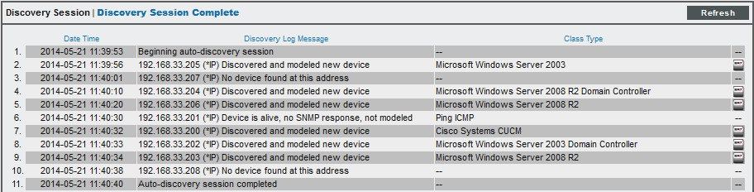
Viewing Discovery Session Logs
System > Manage > Discovery
Add/Remove Devices
Notes:
During or after a dynamic-discovery session, you can get information on the status of the session by viewing the session log. To view the session log for a dynamic-discovery session:
1. Go to System > Manage > Discovery or use the shortcut keys Ctrl + Alt + A.
2. In the Discovery Control Panel, in the Session Register, find the discovery session you are interested in. Select its magnifying glass icon.
3. The Discovery Session modal page appears. This page provides details on the discovery session.

Slide 53
Discovery Session Log Messages
Possible log messages when “Log All” checked, discovering devices:
Discovered and modeled new device - Indicates a new device was discovered and successfully modeled with SNMP. Availability will be measured with SNMP and latency with ICMP.
No device found at this address – There is no device at the address (indicates the EM7 collection server cannot ping or collect snmp data from the device)
Discovered new pingable device – Indicates a new device was discovered that only responds to ICMP. Device availability and latency will be measured with ICMP.
Device is Alive, no SNMP response, not modeled – The device pings, but “Model Non-SNMP” is not checked for the Discovery Session and the device is not responding to SNMP requests
Discovered and modeled existing device – Indicates the device (MAC address) is already in EM7
Add/Remove Devices

Slide 54
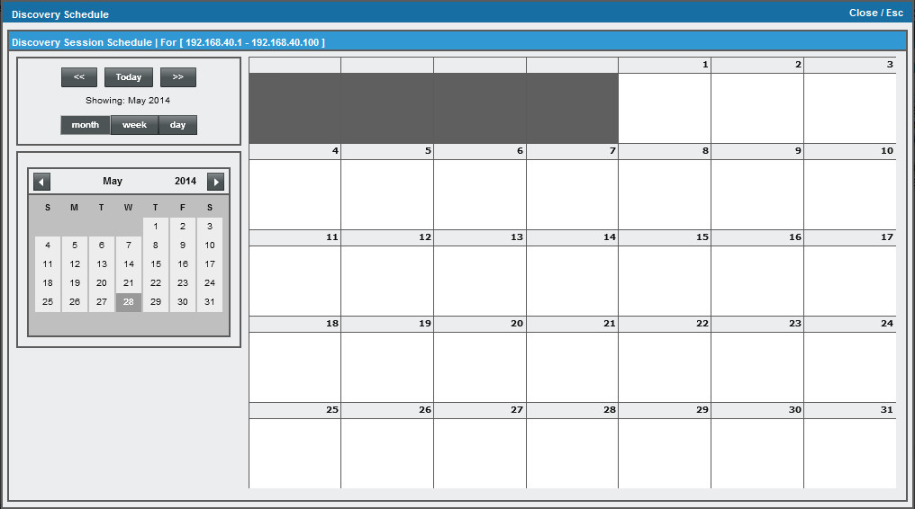
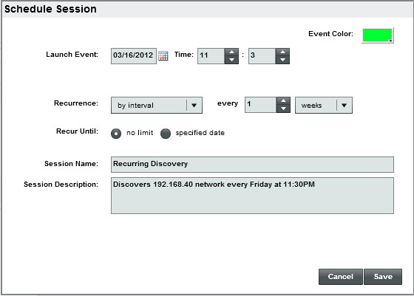
Scheduling a Discovery Session
System > Manage > Discovery > Calendar icon
Add/Remove Devices
Notes:
You can schedule one-time and recurring re-execution of a selected discovery session. You can use the Discovery Session Schedule page to:
Specify regularly recurring discovery of a specific IP range. This is helpful when you want to monitor an IP range where new devices are frequently added.
Specify one-time re-discovery of a specific IP range. This is helpful when you are aware of hardware or software changes within that IP range that you want ScienceLogic to monitor.
NOTE: Scheduled re-execution of a discovery session is slightly different than ScienceLogic's automatic, nightly rediscovery. Nightly rediscovery is applied only to already discovered devices and uses the policies and configuration applied to each device. Re-execution of a discovery session can discover new devices within an IP range and uses only the settings specified in the Discovery Control Panel page.
To schedule the re-execution of a selected discovery session:
Go to System > Manage > Discovery.
In the Discovery Control Panel, go to the Session Register pane at the bottom of the page and find the discovery session you want to schedule. Select its calendar icon.
The Discovery Session Schedule modal page appears, where you can select a date and time to re-execute the discovery session and specify if and how frequently ScienceLogic should automatically re-execute the discovery session.
When you have successfully scheduled a discovery session, in the Session Register pane, you will see a value in the Rediscovery field.

Slide 55
Tip
Challenge: Identify new devices that do not exist in EM7 but are on the production subnet.
Solution: Create an Organization called “New Devices”.
Add a scheduled discovery session to run each night for the production subnet and select “New Devices” as the Organization. This Organization should be checked periodically for devices that should be brought under management.
Add/Remove Devices

Slide 56
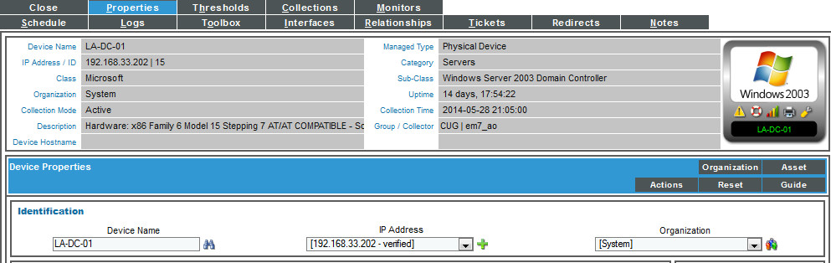
Re-Discovering an Existing Device
Device Administration > Device Properties
Clicking the binoculars will execute a re-discovery session for the device.
Re-discovery will get on-demand information for a device:
Updated list of open ports
Dynamic application alignment
Device class changes
Add/Remove Devices
Notes:
You can manually queue discovery from other places in ScienceLogic.
From the Device Properties page, you can manually run discovery for the single device. To do this, select the Rediscover icon.
From the Management Templates Manager page, you can manually run the Dynamic Application alignment portion of discovery for all devices in the system, using one or more selected Management Templates. To do this, select the checkbox for each dynamic application you want to use for discovery. In the Select Action drop-down, select DISCOVER Applications.

Slide 57
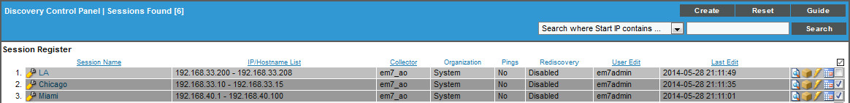
Deleting Discovery Sessions
System > Manage > Discovery
Select the checkbox and press
Add/Remove Devices
Notes:
From the Discovery Control Panel page, you can delete a discovery session. To do this:
Go to System > Manage > Discovery
In the Discovery Control Panel, go to the Session Register pane at the bottom of the page and find the discovery session you want delete. Select its checkbox.
Select the checkbox of each discovery session you want to delete.
Select the Delete button.

Slide 58
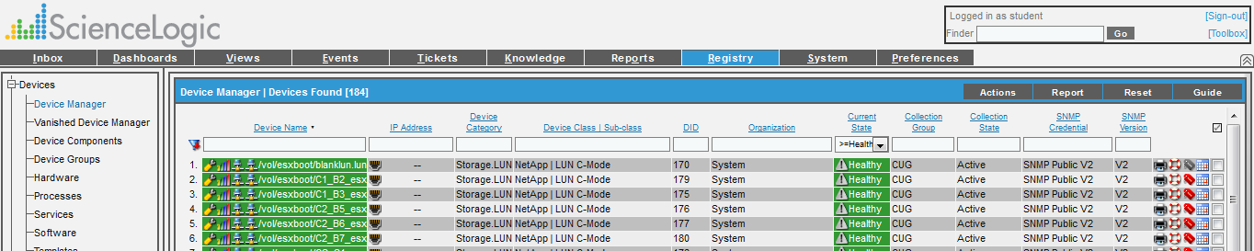
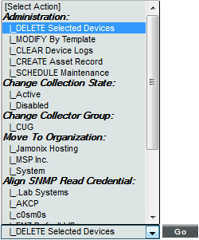
Deleting Devices
Registry > Device Manager
Select device
Go to Select Action DELETE Selected Devices
Click [Go]
Add/Remove Devices

Slide 59
Resources And Questions
For more information:
Discovery and Credentials manual
Guide Button
All manuals are available on the Customer Portal:
http://portal.sciencelogic.com
Add/Remove Devices

Slide 60
Lab Goals
Adding an Organization
Adding a User Account
Adding a Credential
Create Discovery Sessions
Executing a Discovery Session
Deleting a device
Add/Remove Devices

Slide 61
Lab: Add/Remove Devices
Create First Organization
Go to Registry > Accounts > Organizations
Click [Create]
Enter Organization Name “All Star Monitoring-Miami”
Enter Street Address “1234 Main Street”
Enter City “Miami”, State “Florida”, and Postal Code “12345”
For Contact First Name and Contact Last Name put in your First and Last name
Click [Save] button
Add/Remove Devices

Slide 62
Lab: Add/Remove Devices
Create Second Organization
Go to Registry > Accounts > Organizations
Click [Create]
Enter Organization Name “All Star Monitoring-LA”
Enter Street Address “1234 Rodeo Dr”
Enter City “Los Angeles”, State “California”, and Postal Code “12345”
For Contact First Name and Contact Last Name put in your First and Last name
Click [Save] button
Add/Remove Devices

Slide 63
Lab: Add/Remove Devices
Create Third Organization
Go to Registry > Accounts > Organizations
Click [Create]
Enter Organization Name “All Star Monitoring-Chicago”
Enter Street Address “1234 Bears Ave”
Enter City “Chicago”, State “Illinois”, and Postal Code “12345”
For Contact First Name and Contact Last Name put in your First and Last name
Click [Save] button
Add/Remove Devices

Slide 64
Lab: Add/Remove Devices
Create Your User Account
Go to Registry > Accounts > User Accounts
Click [Create]
For First Name and Last Name put in your First and Last name
Enter Account Login Name of first initial last name
Enter Primary Email “enter your e-mail address to receive info”
Enter Password of “em7student”
Uncheck Next Login
For Organization select All Star Monitoring-Miami.
Click [Save] button
Click and drag down to select all queues in Ticket Queue Memberships
For Time Zone select New_York (or Eastern)
Click [SAVE] button
Add/Remove Devices

Slide 65
Lab: Add/Remove Devices
Sign in as the new user account
Click the [Sign-out] link in the top right corner of the banner
Sign in with your new credentials
Agree to EULA at bottom of screen.
Create Credential
Go to System > Manage > Credentials
Click [Create] on the Credential Manager and select SNMP Credential from the options
Enter Profile Name “All Star Monitoring Credential”
Select SNMP v1 from the SNMP Version drop down
Leave the default for Port, Timeout, and Retries
Enter “tr@ining” for the SNMP Community (Read Only)
Click [Save] button and close window
Add/Remove Devices

Slide 66
Lab: Add/Remove Devices
Create First Discovery Session
Go to System > Manage > Discovery
Select the [Create] button to open the Discovery Session Editor
Fill out Name “Miami Data Center”
In IP Address Discovery List enter the ranges (all in that one box):
192.168.33.200
192.168.40.17
192.168.33.210 - 192.168.33.214
In the SNMP Credentials box Select the “All Star Monitoring Credential”
Select “All Star Monitoring-Miami” for the Organization field
Select the Log All checkbox
Click [Save]
Add/Remove Devices

Slide 67
Lab: Add/Remove Devices
Create Second Discovery Session
Go to System > Manage > Discovery
Select the [Create] button to open the Discovery Session Editor
Fill out Name “Chicago Data Center”
In IP Address Discovery List enter the range:
192.168.33.10 - 192.168.33.15
192.168.33.204, 192.168.33.205
In the SNMP Credentials box Select the “All Star Monitoring Credential”
Select the checkbox for Discover Non-SNMP (make sure to leave the Model Devices one checked as well)
Select “All Star Monitoring-Chicago” for the Organization field
Select the Log All checkbox
Click [Save]
Attention!
Add/Remove Devices

Slide 68
Lab: Add/Remove Devices
Create Third Discovery Session
Go to System > Manage > Discovery
Select the [Create] button to open the Discovery Session Editor
Fill out Name “Los Angeles Data Center”
In IP Address Discovery List enter the range:
192.168.33.202, 192.168.33.203
In the SNMP Credentials box Select the “All Star Monitoring Credential”
Select “All Star Monitoring-LA” for the Organization field
Select the Log All checkbox
Click [Save]
Add/Remove Devices

Slide 69
Lab: Add/Remove Devices
Execute the Discovery Sessions
Go to System > Manage > Discovery
Find each of the newly created Discovery Sessions (Miami, Chicago, and Los Angeles) and use the Lightning Bolt icon to start the discovery process.
At the conclusion of the discovery’s there will be between 9 and 13 devices on the Device Registry
Delete a Device
Go to [Registry]
Select the Checkbox for one of the pingable devices
Select Delete Device from the Select Action drop down and hit [Go]
Add/Remove Devices

Slide 70






Device Management

Slide 71
Objectives
Device Summary
Registry page view
Device Properties
Registry page view
Device Management

Slide 72

Overview of Device Administration
Device Reports Panel:
Device Summary
Performance Graphs
Lists of Ports, Process, Services
Interface information
Device Administration Panel:
Device Properties
Link log messages to Event Definitions
Manage Maintenance Schedules
Adjust Thresholds
Device Management

Slide 73
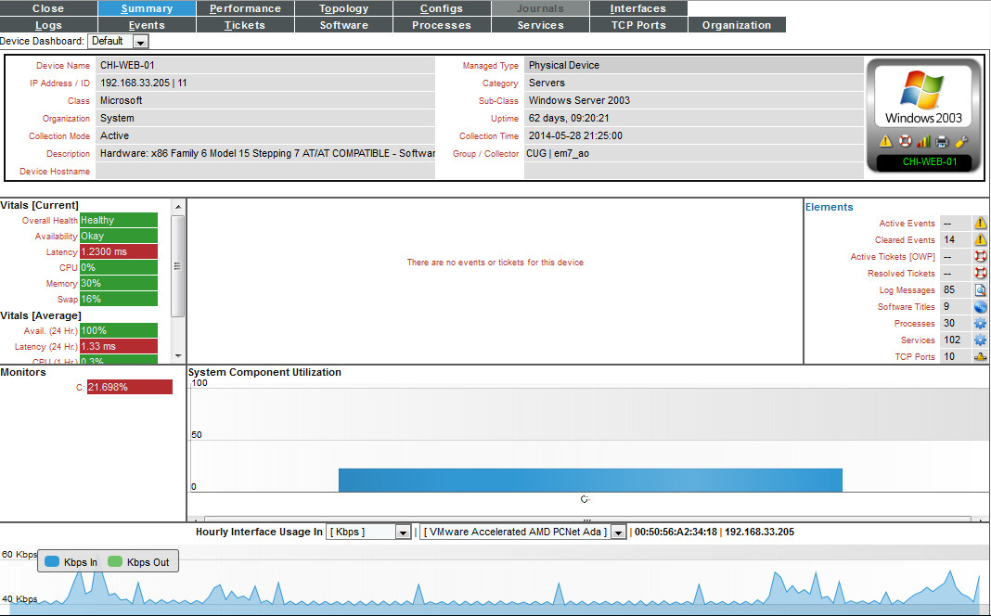
Device Summary
Device Info Pane highlights:
Last collection time
Device SNMP Agent Uptime
Organization, Hostname, IP Address
Shortcuts to SNMP Walker and Remote Port Scanner
The “Graph” icon
If a tab is greyed out, that type of data is not being collected
A Summary of Tickets, Events, and Vitals on a single device
Management interface data
Device Management
Notes:
The Device Summary tools allow you to view detailed information that ScienceLogic has gathered from each device and view reports generated from that information.
To access the Device Reports tools for a device, select its bar-graph icon.
The Device Summary page provides a one-stop overview of a device, including a list of events and tickets, a list of running processes and hardware, a list of interfaces and ports, availability and performance information, bandwidth information, and information on the file system. You cannot edit any of the device’s properties in this page.

Slide 74
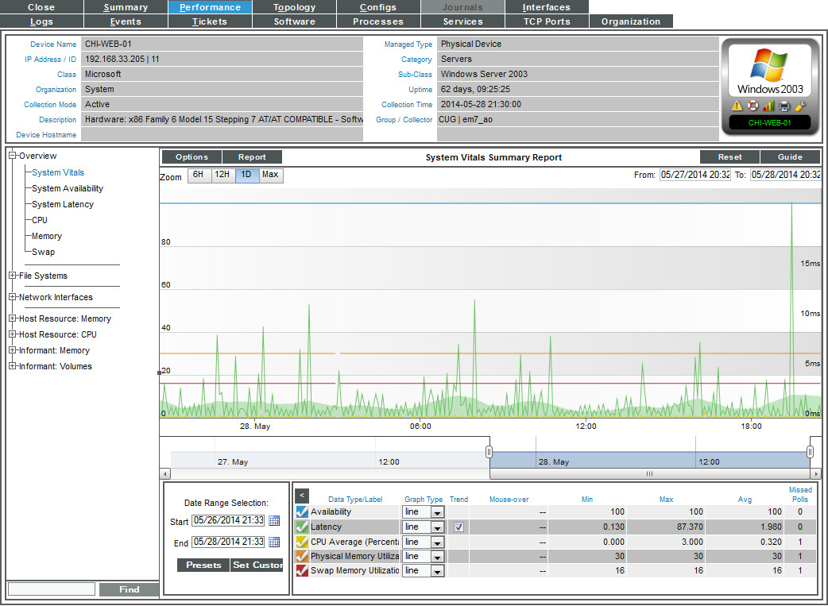
Performance Tab
Device Reports Panel > Performance
View performance graphs
Small date ranges = Raw data
Long date ranges = Normalized data
Run embedded performance reports
Performance reports for the device
List of links available for the device
Device Management
Notes:
The Performance page allows users to view many detailed reports for the selected device. Users can view reports on:
o System Vitals
o System Availability
o System Latency
o CPU Usage (both for an entire device and for individual CPUs)
o Physical Memory Usage
o Virtual Memory Usage
o File Systems Usage (both for an entire device and for individual file systems)
o Network Interfaces and bandwidth usage
o Domain Name Availability
o Email Round Trip speed
o SOAP/XML Transactions
o System Process Availability
o TCP/IP Port Availability
o Web Content Availability
o As well as custom reports based on data collected from monitored device

Slide 75
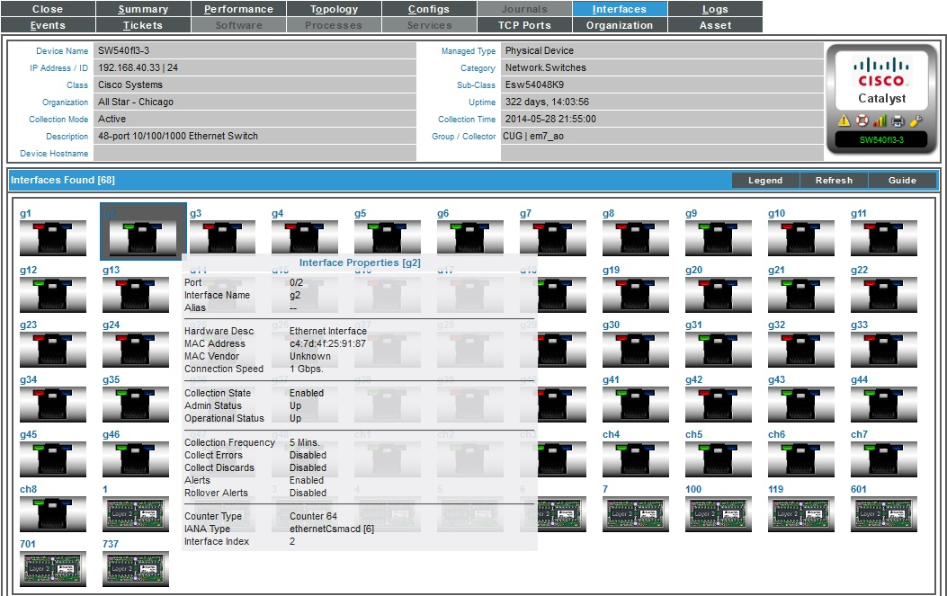
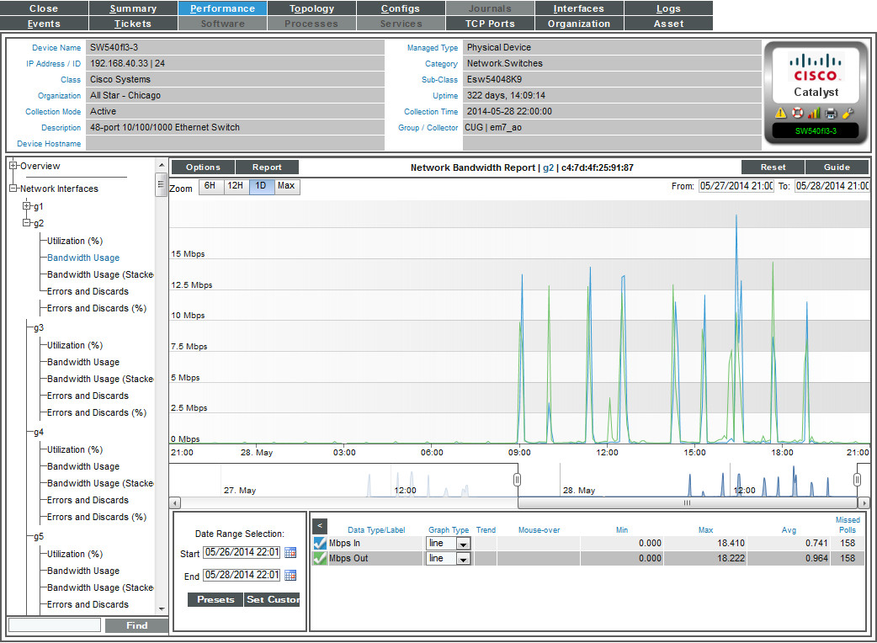
Interfaces Tab
Device Reports Panel > Interfaces
Interface drill-down to detailed information
View IP, Subnet, MAC Address per Interface
Interface speed, duplex, counter, operational and admin status
Polling frequency
Interface errors and discards
Device Management
Notes:
The Interfaces Found page displays detailed information about each network interface on the device.
The Interfaces Found page allows you to view a list of all interfaces on the device, view details about each interface, and view bandwidth usage reports for each interface

Slide 76
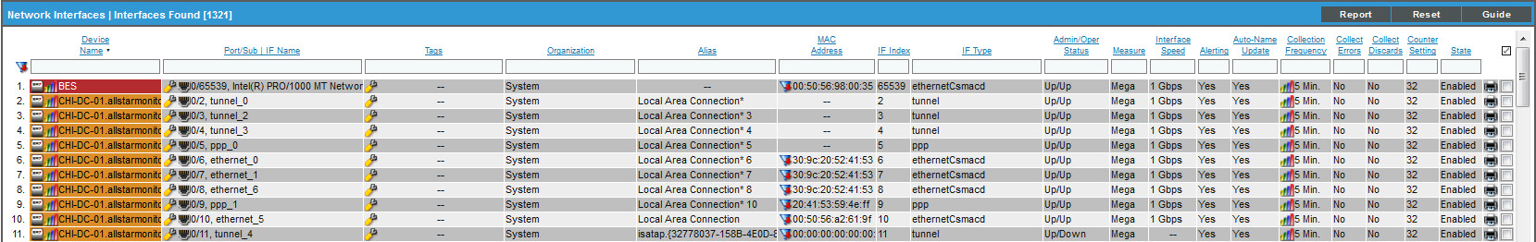
Interface Registry
Registry > Networks > Interfaces
The Network Interfaces page displays a list of all interfaces discovered by EM7.
View details on each interface.
Define a monitoring policy for an interface
View bandwidth reports on each interface.
Device Management
Notes:
The Network Interfaces page displays the following for each interface:
Device Name. Name of device where interface resides.
Port/Sub. Port and sub-port (if applicable ) of the interface.
IF Name. The name of the network interface. The auto-name, generated by ScienceLogic, is device name:interface_number. Users can define a different name in the Interface Properties page.
Alias. User-defined name assigned to the interface.
MAC Address. Short for Media Access Control Address. A unique number that identifies the interface. MAC Addresses are defined by the hardware manufacturer.
IF Index. A unique number (greater than zero) that identifies each interface on a device. These numbers are defined within the device.
IF Type. A string that describes the type of interface, as defined by the standards group Internet Assigned Numbers Authority.
Status. Two-part status.
o Administration Status. Specifies how the network interface has been configured on the device.
o Operation Status. Specifies current state of the network interface.
Measure. Unit of measurement for bandwidth reports for the interface.
Interface Speed. The number of megabits per second that can pass through the network interface.
Alerting. Specifies whether or not events will be generated for the selected interfaces.
Auto-Name Update. Specifies whether or not ScienceLogic will update and/or over-write the interface name during nightly dynamic-discovery.
Collection Frequency. When you define a monitoring policy for an interface, you must specify how frequently you want ScienceLogic to collect data from the interface.
Collect Errors. Specifies whether or not ScienceLogic will collect data on packet errors on the interface.
Collect Discards. Specifies whether or not ScienceLogic will collect data on interface discards.
Counter Setting. Specifies whether the interface uses a 32-bit counter or a 64-bit counter to measure bandwidth on the interface.
State. Enabled or Disabled.
Edit Date. Date and time the monitoring policy for interface was created or last edited.
Report Button. Generates a report on all interfaces.

Slide 77
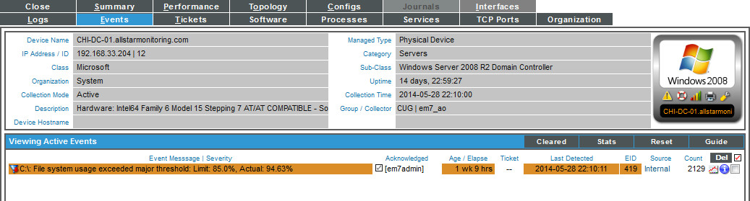
Events Tab
Device Reports Panel > Events
View active and cleared events for this device
Clear or Acknowledge events for this device
Suppress an event for this device
Device Management
Notes:
To view a list of events for a single device:
1. Go to the Device Manager page (Registry > Devices > Device Manager).
2. Find the device that you want to view events for. Select its bar graph icon.
3. In the Device Reports panel, select the Events tab.
4. The Viewing Active Events page appears.

Slide 78
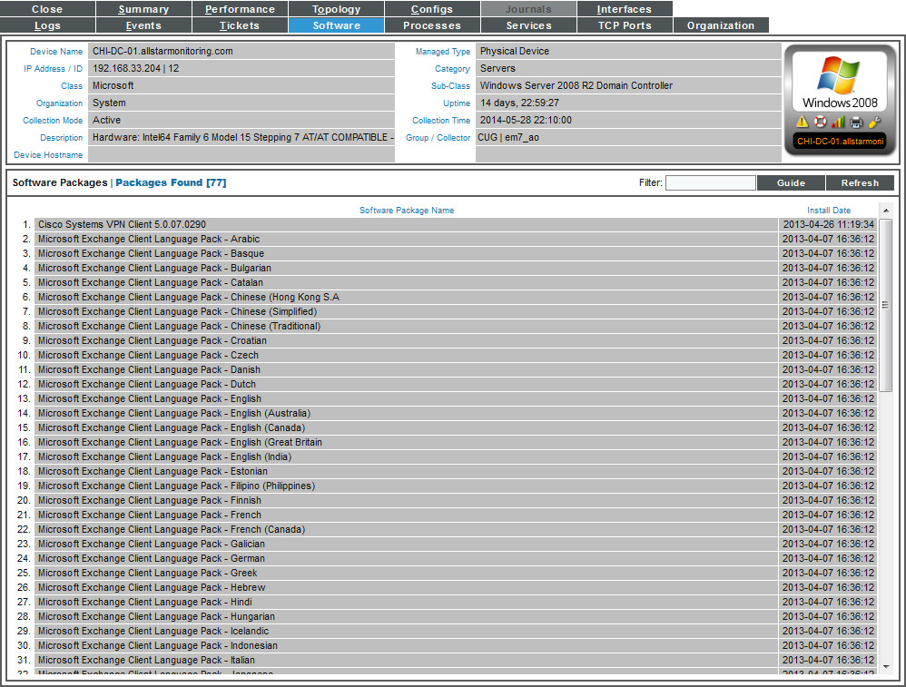
Software Tab
Device Reports Panel > Software
Software Titles
Software install date
Software Inventory is collected every 60mins (software_inventory_update.py)
Device Management
Notes:
The Software Packages page displays a list of all the software installed on the device. If possible, the installation date is also displayed.

Slide 79
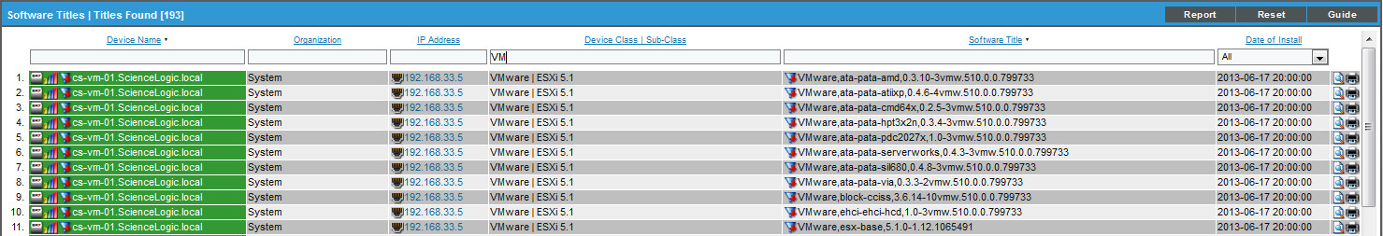
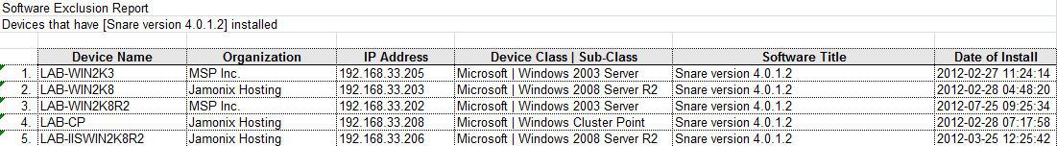
Software Titles
Registry > Devices > Software
The Software Titles page displays a list of all software discovered by EM7.
Generate an Excel report on all discovered software.
Generate an exclusion report for a single software title.
Device Management
Notes:
The Software Titles page displays the following for each service:
Device Name. Name of the device.
Organization. Organization associated with the software.
IP Address. IP address of the device where the software is installed.
Device-Class / Sub-Class. The manufacturer (device class) and type of device (sub-class). The Device-Class/Sub-Class is automatically assigned during auto-discovery, at the same time as the as Category.
Software Title. Name of the software.
Date of Install. Date the software was installed.
Report Button. Generates report on all software titles.

Slide 80
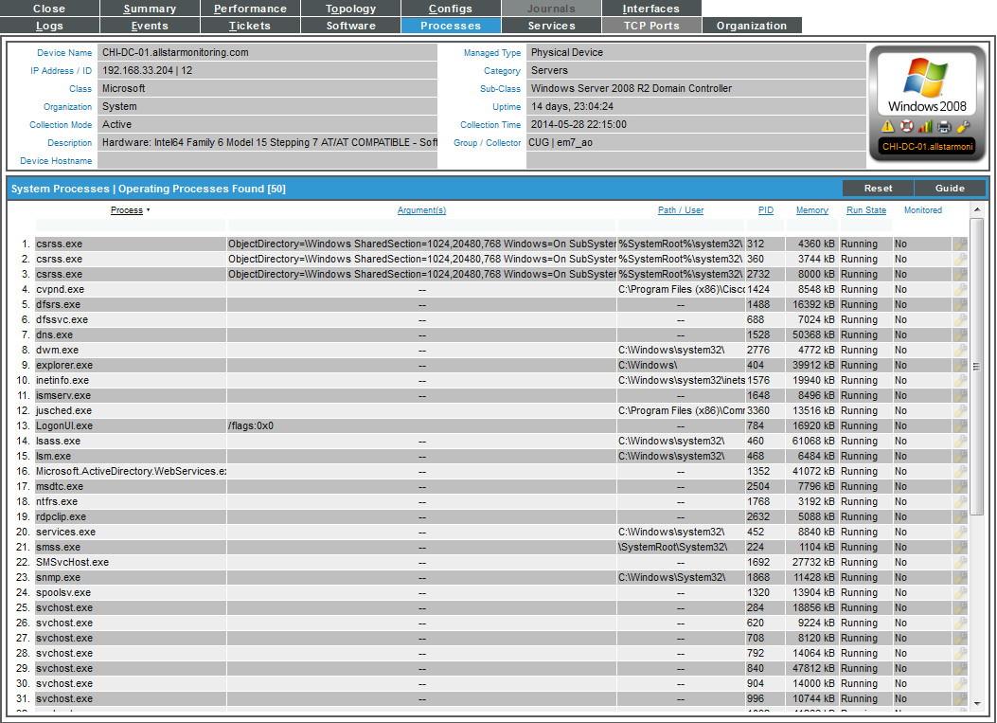
Process Tab
Device Reports Panel > Processes
List of running processes
Arguments per process
Path of process
PID
Amount of memory consumed per process
Process monitored or not
List of processes is collected every 120mins
(process_collect.py)
If the process is monitored, the process check is every 5 minutes (process_check.py)
Device Management
Notes:
The System Processes page displays information about the processes running on the device.
A process is a program that is currently running on a monitored device or has been run in the past and is currently idle. Sometimes a process is called a task.
To keep your device running efficiently and to maintain security, the System Processes page helps you manage processes on your device. The System Processes page allows you to easily view details about each process running on the device.

Slide 81
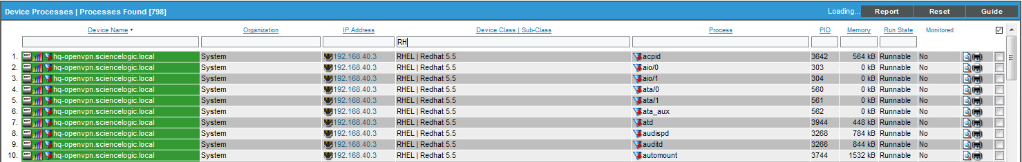
Device Processes
Registry > Devices > Processes
The Device Processes page displays an aggregate list of processes discovered by EM7 for all devices.
Allows you to easily view details on processes.
Create monitors for system processes.
Generate reports on processes, all from a single page.
Device Management
Notes:
The Device Processes page displays the following for each process:
Device Name. Name of the device where the process resides.
Organization. Organization associated with the process.
IP Address. IP address of the device where the process is located.
Device-Classification / Sub-Class. The manufacturer (device class) and type of device (sub-class). The Device-Class/Sub-Class is automatically assigned during auto-discovery, at the same time as the as Category.
Process. The name of the process. A single process name can have multiple entries.
PID. A unique ID for the process. The device's operating system assigns this value.
Memory. The amount of memory currently used/reserved for the process.
Run State. The current state of the process. This can be one of the following:
o Runnable. Process is ready to run as needed.
o Running. Process is currently running.
o Not Running. Process is in a "waiting" state. Invalid. Process is part of an operation that failed. Process was not ended gracefully.
Monitored. Specifies whether or not ScienceLogic is monitoring the process.
Tools. For each process, the following tools are available:
o Locate all processes on device (Magnifying icon). Leads to the System Process page, where you can view a list of all processes that reside on the device.
o Print exclusion report (Printer icon). Generates a detailed process report, in MS Word format. This report specifies all devices where the selected process is running and all devices where the selected process is not running. ScienceLogic lists only appropriate servers in this report. For example, Solaris servers would not appear in a report for a Microsoft process.
o Edit monitoring of this process(Wrench icon). Leads to the Monitoring Policies page, where you can edit the properties of the monitoring policy.
o checkbox. The checkbox applies the action from the Select Action drop-down list to the process. To select all the checkboxes, select the large red check icon.
Report Button. Run report on processes for all devices.

Slide 82
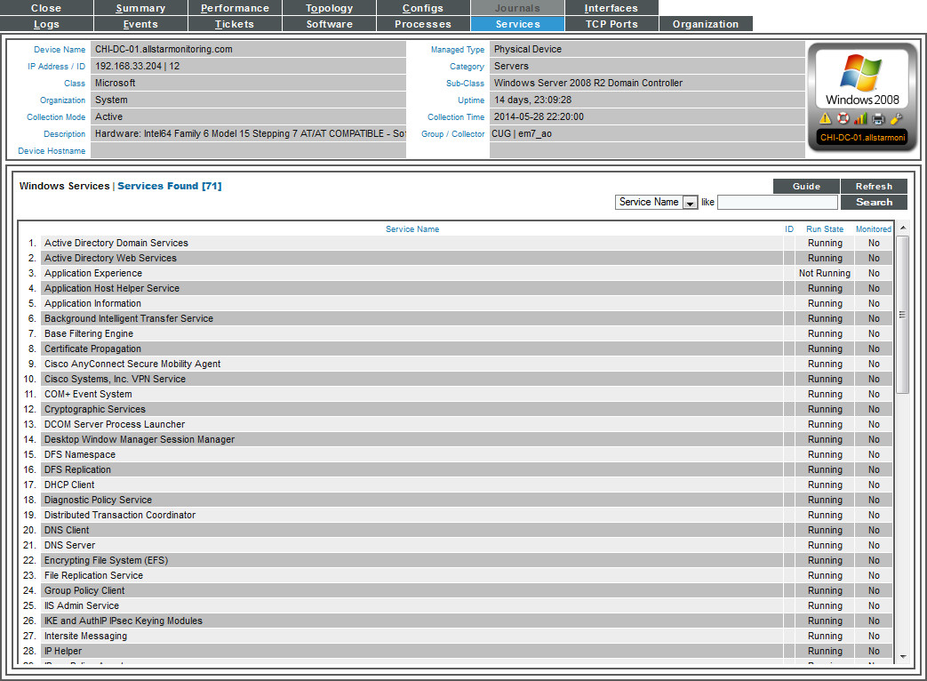
Services Tab
Device Reports Panel > Services
List of services running on the device
Run state of the service
Service monitored or not
List of services collected every 120mins (service_collect.py)
If the service is monitored, the service check is every 5mins (service_check.py)
Device Management
Notes:
The Windows Services page displays a list of all Windows services enabled on the device.
Windows Services are long-running applications. These applications typically do not have a user interface or produce any visual output. Any messages associated with the service are typically written to the Windows Event Log. Services can be configured to start automatically when the computer is booted. Services do not require a logged in user in order to execute.
To keep your device running efficiently and to maintain security, the Windows Services page helps you manage services on your device. The Windows Services page allows you to easily view details on all the services running on the device.

Slide 83
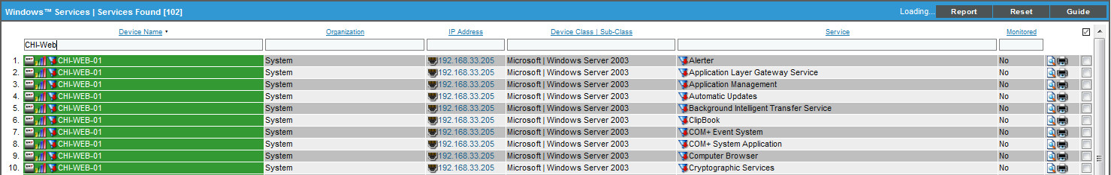
Windows Services
Registry > Devices > Services
The Windows Services page displays an aggregate list of services for all managed devices.
Filter or search for Services.
Create monitors for Windows services.
Generate reports on services, all from a single page.
Device Management
Notes:
The Windows Services page displays the following for each service:
Device Name. Name of the device where the service resides.
Organization. Organization associated with the device.
IP Address. IP address of the device where the service is located.
Device-Classification / Sub-Class. The manufacturer (device class) and type of device (sub-class). The Device-Class/Sub-Class is automatically assigned during auto-discovery, at the same time as the as Category.
Service. The name of the service. A single service name can have multiple entries.
Monitored. Specifies whether or not ScienceLogic is monitoring the service.
Tools. For each service, the following tools are available:
o Locate all services on device (Magnifying icon). Leads to the Services Found page, where you can view a list of all services that reside on the device.
o Print exclusion report (Printer icon). Generates a detailed service report, in MS Word format. This report specifies all devices where the selected service is running and all devices where the selected service is not running. ScienceLogic lists only appropriate devices in this report. For example, Solaris servers would not appear in a report for a Microsoft service.
o Edit monitoring of this service(Wrench icon). Leads to the Monitoring Policies page, where you can edit the properties of the monitoring policy.
o checkbox. The checkbox applies the action from the Select Action drop-down list to the service. To select all the checkboxes, select the large red check icon.
Reports Button. Runs services report on all devices.

Slide 84
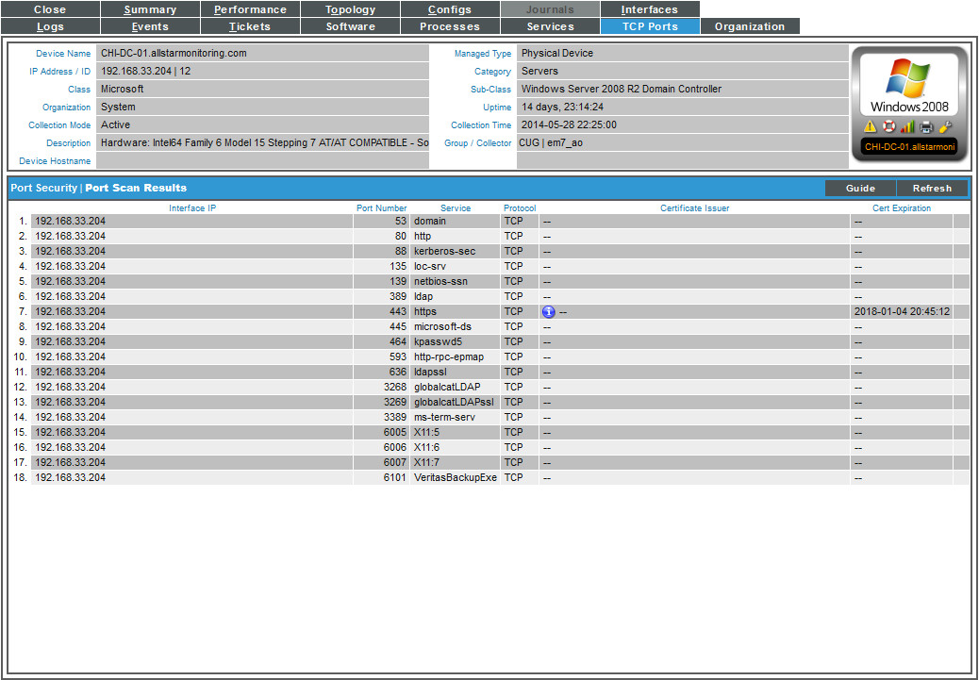
TCP Ports Tab
Device Reports Panel > TCP Ports
Lists open TCP ports per IP address
SSL certificate expiration dates are automatically monitored per global setting
Open TCP ports and SSL certificate information is collected once a day
If the port is monitored, the port check is every 5mins (port_collect.py)
Device Management
Notes:
The Port Security page displays a list of all open ports on a device.
TCP/IP ports are used to route packets on a server to the appropriate network application. For example, port 80 is the standard port number for HTTP traffic, and port 80 packets are processed by a Web server. Ports 0-1023 are used by common Internet applications such as HTTP, FTP and SMTP. Ports 1024-49151 can be registered by vendors for proprietary applications.
ScienceLogic scans each device's TCP and UDP ports and displays the results in the Port Security page. All open ports will be displayed in the Port Security page. ScienceLogic uses a stealth scanning tool that does not initiate communication sessions with the ports. This increases the speed and safety of the port scanner.
Every night, ScienceLogic scans all the ports of each managed device. If any new ports are opened, ScienceLogic updates the Port Security page and creates an event to notify users. You can explicitly ask that a device not be scanned nightly, but if you do, ScienceLogic will not notify you of newly opened ports on the device.

Slide 85
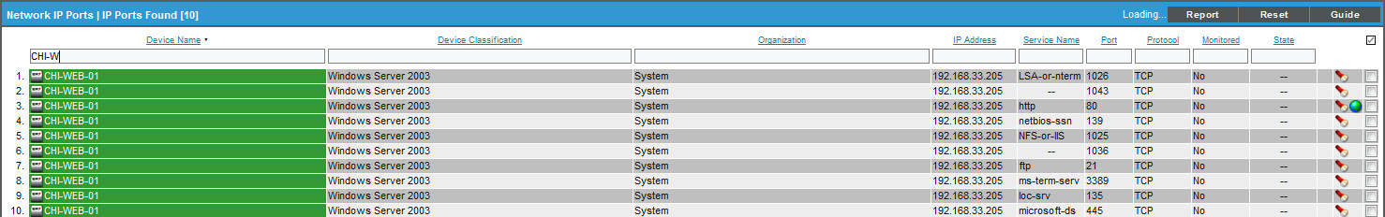
IP Ports Registry
Registry > Networks > IP Ports
The IP Ports page displays an aggregate list of listening IP ports for all managed devices.
Create monitors for port-monitoring to multiple ports on multiple devices.
Generate reports on IP Ports, all from a single page
Device Management

Slide 86
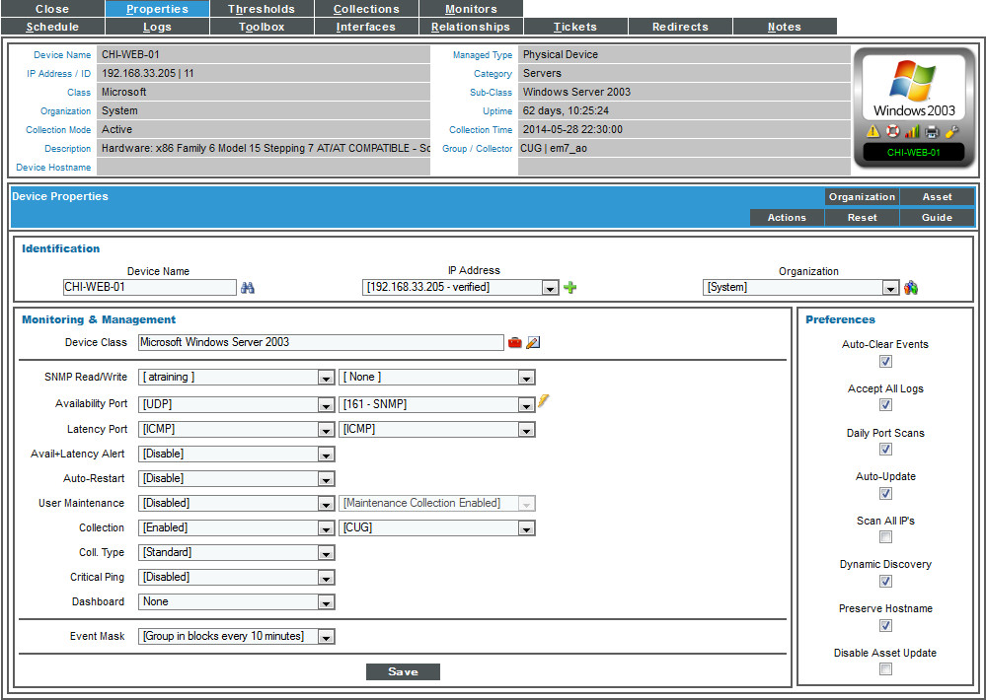
Device Properties
The “Wrench” icon
Last time availability was collected
Move device to another Organization
Enable/Disable collection and collector assignment
On-demand availability check
Device Management
Notes:
The Device Administration tools allow you to define how ScienceLogic will interact with a device. This includes defining the
data that will be retrieved, the frequency with which ScienceLogic will poll the device, and policies and thresholds that will
generate events for the device.
To access the Device Properties tools for a device, select its wrench icon. In the Device Properties page, you can edit parameters that affect how ScienceLogic “sees” the device and monitors the device.
You can edit one or more of these fields for the device. The settings defined for the device in the Device Properties page override any system-wide settings.
Beside the Device Name is the Rediscover this Device icon (binoculars). This icon queues the device for discovery. ScienceLogic will create and run a new Discovery Session for the primary IP addressof this device.
If a device has multiple IP addresses, you can define those IP addresses in ScienceLogic. ScienceLogic will continue to use the primary IP address for communication with the device. However, ScienceLogic will also collect data about the additional IP address(es). To the right of the IP Address field, click on the plus-sign icon.
Change Device Class icon (Red Box) Displays the Select New Device Class modal page, where you can select a device class to associate with this device.
Run Availability Policy icon (Lightning Bolt). When you select this icon, ScienceLogic immediately checks the availability of the device, using the port and protocol specified in the Availability Port fields. ScienceLogic displays a Session Logs modal page that displays detailed description of each step of the availability policy.

Slide 87
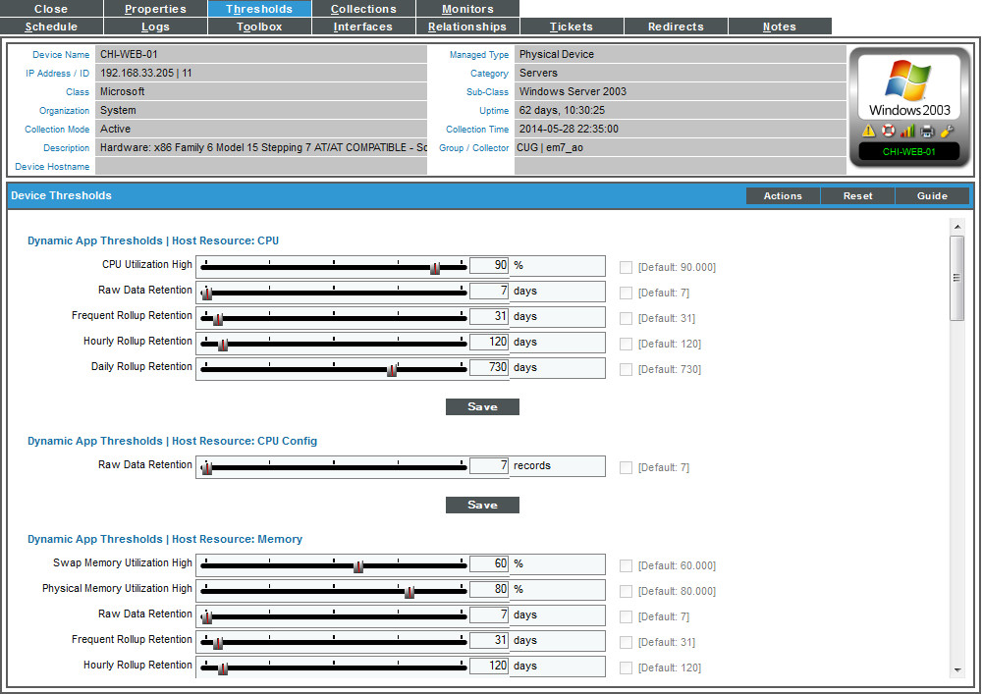
Thresholds Tab
Device Administration > Thresholds
Adjust device thresholds
Dynamic application Thresholds
File System Thresholds
Operating System Thresholds
Data Retention Thresholds
Device Thresholds Override Global Thresholds
Device Management
Notes:
The Device Thresholds page allows you to define usage and performance thresholds and data retention thresholds for a device. When these thresholds are exceeded, ScienceLogic will generate an event for the device.

Slide 88
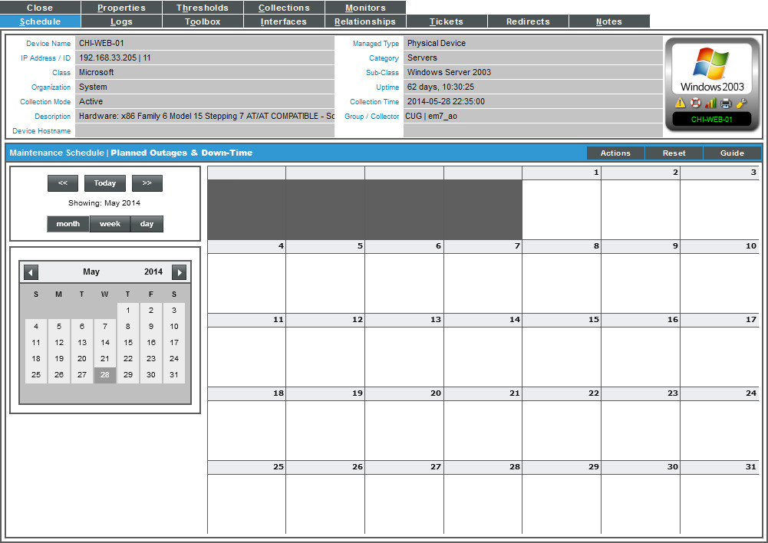
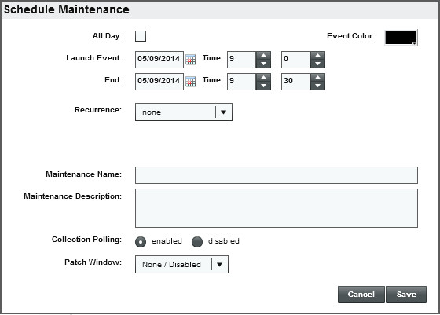
Schedule Tab
Device Administration > Schedule
Maintenance schedule per device
Planned outages & downtime
Enable or Disable collection polling for each planned outage
Schedule one-time or recurring maintenance windows
Device Management
Notes:
The Maintenance Schedule page allows you to view a calendar and schedule one-time and recurring maintenance tasks and downtime for the single device. You can use the Maintenance Schedule page to:
Specify recurring downtime for routine maintenance (for example, a weekly database backup that occurs every Tuesday at 3 AM).
Specify one-time downtime (for example, when upgrading software or hardware).
When a device is in maintenance, ScienceLogic will not generate events about the device. You can choose to enable or disable polling during maintenance mode. Even if polling is enabled during maintenance, ScienceLogic will collect information from the device but will not generate events for the device.

Slide 89
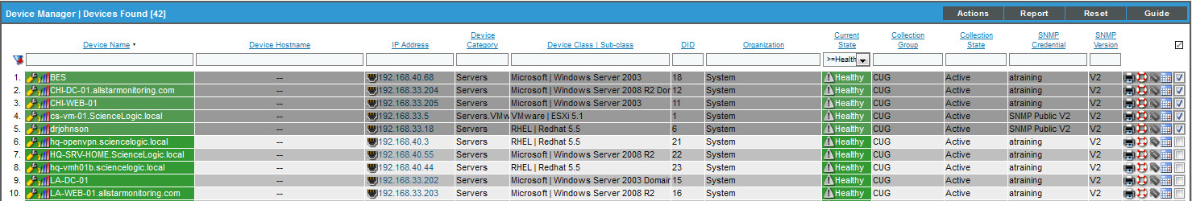

Bulk Maintenance Scheduling
Registry > Device Manager
Select devices to schedule maintenance on
Select Actions > SCHEDULE Maintenance
[GO]
Device Management

Slide 90

Logs Tab
Device Administration > Logs
List of device logs & messages
Search all messages (supports regex)
Filter on message source (internal, trap, syslog, dynamic, email and 3rd party)
Create custom event definitions based off log entries (syslog, trap, and email)
Device Management

Slide 91

Toolbox Tab
Device Administration > Toolbox
Run diagnostics for a managed device without leaving the EM7 session.
Tools run from the collector that is assigned to the managed device.
Device Management

Slide 92

Interfaces Tab
Device Administration > Interfaces
Mouse over for quick info about interface
If name
MAC Address
Admin Status
Connection Speed
IP address / subnet
Collection state / frequency
Interface type
Device Management

Slide 93

Interfaces Properties
Device Administration > Interfaces (select an interface)
Change collection frequency
Enable / Disable alerts
Enable / Disable errors & discards
Set thresholds per interface
Specify Interface Tags
Display on Summary checkbox will cause this interface to show on the Device Reports Panel > Summary tab
Device Management

Slide 94

Pro Tip
There are links in the Device Summary & Device Properties to useful utilities.
Organization = Organization Summary page
Collection Mode = Remote Port Scanner
Managed Type = SNMP Walker
Device Management

Slide 95
Resources And Questions
For more information:
Device Management manual
Guide Button within EM7
All manuals are available on the Customer Portal:
http://portal.sciencelogic.com
Device Management

Slide 96
Lab Goals
Adjust Device Threshold
Summary drill down to Memory
View Raw vs. Hourly vs. Daily and run a report
View threshold event
Reset Threshold
Device Management

Slide 97

Lab: Device Management
Add threshold and view utilization:
Add device Threshold:
Go to Registry tab
Select the “studentxx” device click the icon
Go to Device Administration > Thresholds
Change the Physical Memory Utilization High field to “1”
Click [Save]
Summary drill down to Physical Memory Utilization :
Select the from the device icon in upper right
From the Performance tab select Memory Utilization from the Overview section of the navigation area
View the Raw Data presented on the graph.
Now click the Report button and select HTML With Images. If the report does not run check the to see if Pop up blocker blocked it.
Device Management

Slide 98
Lab: Device Management
View and reset threshold
(continued from previous slide)
Close the report
Select the Options button next to reports, and select Normalized Daily
Notice the change to the graph, select the Normalized Hourly, and observe the change. Stay on the page for next lab.
View Threshold Event and Reset
Select the Summary tab
In the panel called Tickets and Events is the event created by you when the threshold was set earlier.
Select the event and Click, this opens the Event Summary
View the event info and Select the Actions button
Select Edit Device Thresholds from the dropdown
Device Management

Slide 99
Lab: Device Management
(Continued from previous slide)
The Device Administration > Threshold tab opens
Change the Physical Memory Utilization High field back to “80”
Select [SAVE]
The event will clear and the healthy will come in during the next polling cycle
Device Management

Slide 100

Device Monitors

Slide 101
Objectives:
What is a Monitoring Policy?
Create different monitoring policies on a device
Bulk Creation of monitoring policies
View the monitoring policies
Delete monitoring policies
Device Monitors

Slide 102

What is a Monitoring Policy?
For each device in EM7 you can define the following types of monitoring policies:
Domain Name
Email Round-Trip
SOAP/XML Transaction
SSL Certificates
System Process
TCP/IP Port
Web Content
Windows Service
3 Methods to Create a Monitoring Policy:
Device Administration > Monitors
Registry > Monitors
Device Templates
All Monitoring Policies have built-in “Internal” events for healthy and fault
Device Monitors
Notes:
A device configuration template contains pre-defined settings for all the fields in the Device Properties page (except device name and device IP) and all fields in the Device Thresholds page.
When you apply a configuration template to a device group, all the devices in the device group will inherit the field values from the configuration template. Therefore, you will not need to manually define settings for each device in the Device Properties page and the Device Thresholds page.

Slide 103

Creating Monitoring Policy
Device Administration > Monitors > Create
= Edit Policy
= Performance View
= Execute now
= Delete Monitor
= Create
Device Monitors

Slide 104

TCP/IP Port Monitor: Per Device Create
Device Administration > Monitors > Create > Create TCP/IP Port Policy
All monitoring policy checks run every 5 minutes
Device Monitors

Slide 105


TCP/IP Port Monitor: Bulk Create
Registry > Network > IP Ports
Create or Delete TCP/IP Port policies in bulk
Filter & Find while you type search
Device Monitors

Slide 106


TCP/IP Port Policies: View
Device Administration > Monitors
Registry > Monitors > TCP-IP Ports
Shows all TCP/IP Port monitoring policies system wide
Device Monitors

Slide 107

TCP/IP Monitor Policy: Performance View
Device Reports > Performance > TCP/IP Port Monitor
All Monitor policies are available on the Performance tab for availability trending
Device Monitors

Slide 108


Deleting Monitoring Policies
Registry > Monitors
Select the Checkbox next to the monitor
Select Action: Delete Monitors
[Go]
Device Administration > Monitors
Device Monitors

Slide 109
Tip
EM7 comes with plenty of out-of-the-box monitoring. Device Monitors give you another layer of monitoring that can be configured for different device types. Device Monitors can be implemented on a single device, in bulk via the Registry > Device Manager or by a Device Template.
Monitoring Policies are considered internal checks. All related event definitions will be “internal” for their source
Device Monitors

Slide 110
Resources And Questions
For more information:
Monitoring Policies
Guide button within EM7
All manuals are available on the Customer Portal:
http://portal.sciencelogic.com
Device Monitors

Slide 111
Lab Goals
Create a TCP/IP Monitor Policy
Create a Windows Service Policy
Delete a Monitor Policy
Device Monitors

Slide 112
Lab: Create a Monitor Policy
Create TCP/IP Port Monitor
Go to Registry > Device Manager
Select the 192.168.33.203 device and click the [Wrench] to bring up the Device Administration page
Select the [Monitors] tab
Select the [Create] button
From the drop down select Create TCP/IP Port Policy
Select port 80 from the drop down field Port/Service
Click [Save]
Device Monitors

Slide 113
Lab: Create a Monitor Policy
Create Windows Service Policy
Go to Registry > Device Manager
Select the 192.168.33.203 device and click the [Wrench] to bring up the Device Administration page
Select the [Monitors] tab
Select the [Create] button
From the drop down select Create Windows Service Policy
Select Windows Update from the drop down field Service Name
Click [Save]
Click on from the Device Icon in upper right corner
Instructor will stop the service on the server
Device Monitors

Slide 114
Lab: Create a Monitor Policy
Delete a Monitoring Policy
Go to Registry > Device Manager
Select 192.168.33.203 and click the [Wrench] to bring up the Device Administration page
Select the [Monitors] tab
Click the bomb icon next to the policies
Device Monitors

Slide 115

Device Templates

Slide 116
Objectives
Describe Device Templates
Create Device Templates
Apply Device Templates
View / Delete Device Templates
Device Templates

Slide 117

What is a Device Template?
Allows you to save a device configuration, apply it to one or more devices, and reuse the same configuration over and over again
Can be applied:
In Discovery Sessions
In Bulk in the Device Manager
To Device Groups
Template Tabs and Settings:
Configuration (Device Properties settings)
Interface settings
Content Verification Policies
TCP/IP Port Policies
Windows Service Policies
System Process Policies
Dynamic Applications
Device Templates
Notes:
A device configuration template contains pre-defined settings for all the fields in the Device Properties page (except device name and device IP) and all fields in the Device Thresholds page.
When you apply a configuration template to a device group, all the devices in the device group will inherit the field values from the configuration template. Therefore, you will not need to manually define settings for each device in the Device Properties page and the Device Thresholds page.

Slide 118

Templates: Creating Templates
Registry > Devices > Templates > Create
Device Templates
Notes:
You can use a device template in multiple ways:
You can apply a device template to a device group to automate the configuration of all devices in the device group.
From the Device Manager page (Registry > Devices > Device Manager), you can apply a device template to one or more selected devices to automate the configuration of the selected devices.
From the Device Group page (Registry > Devices > Device Groups), you can use the bulk configuration tool to apply configuration settings to all the devices in a device group. These configuration settings do not have to be defined or saved in a device template.
From the Device Manager page (Registry > Devices > Device Manager), you can use the bulk configuration tool to apply configuration settings to one or more selected devices. These configuration settings do not have to be defined or saved in a device template.
To define a new device template, perform the following steps:
1. Go to Registry > Devices > Templates.
2. In the Configuration Templates page, select the [Create] button.
3. The Device Template Editor page appears.

Slide 119

Active and Inactive Fields on Templates
Active
Inactive
Click Field Title to activate the field for the Template
Greyed out fields are inactive and will not be part of the Template.
Only the Active fields will be applied via the Template
Device Templates

Slide 120

Templates: Adding Policies
Registry > Devices > Templates > Create
To add a Policy to a Template, select the Green Plus Sign next to Add New …..
Policies have options to “Add Only to Devices…” that have that context
Select [Save]
Device templates are not persistent. That is, when you update or change a device template, no changes are made to any devices that have had the template applied to them in the past.
Device Templates

Slide 121


Templates: Applying
Registry > Device Manager
Action Drop Down
MODIFY By Template
System > Manage > Discovery
In a Discovery Session one Template can be specified
Should be used only if one device is being discovered or all devices need same setting
Device Templates
Notes:
To use the Modify by Template action to apply settings to one or more devices:
1. Go to Registry > Devices > Device Manager.
2. In the Device Manager page, select the checkbox for each device you want to apply configuration settings to.
3. In the Select Actions field, in the lower right, select the option Modify by Template.
4. The Bulk Device Configuration page appears.
In the Template field, select New/One-Off Template
Save When Applied & Confirmed. From the Bulk Device Configuration page, you can edit the value in any of the fields in any of the tabs of the device template. The edited values will be applied to the selected devices. You do not have to save the edited values in a device template; they can be for one-time only use.
o If you select this field, any changes you make to fields in the Bulk Device Configuration page will be saved to a new template.
o If you don't select this field, you can edit the values in any of the fields, and the edited values won't be saved, but will be applied to the selected devices.
5. Select the [Apply] button to apply the field values to the selected device(s).
6. The Device Setting Confirmation page appears.

Slide 122




Templates: Applying to Device Group
Registry > Devices > Device Groups
Click on the “Bulk Device Configuration” icon
Either select a preexisting template or make changes in the device template editor as a “New / One-Off” template
Select [Apply], then review and [Confirm] the changes
NOTE: If the definition for a Device Group, in the Device Group Editor page does not include Config Policies/Bulk Edit in the Visibility field, you cannot apply a device template to the device group.
Device Templates

Slide 123


Templates: View / Delete
Registry > Devices > Templates
Select the Template to delete
Select the Select Actions dropdown and Delete Templates
Select [GO], then review and [Confirm] the changes
Device Templates
Notes:
To view a list of existing device templates:
1. Go to Registry > Devices > Templates.
2. The Configuration Templates page displays a list of existing device templates.
3. The Configuration Templates page displays the following about each device template:
Template Name. Name of the configuration template.
ID. Unique, numeric ID, assigned to the device template automatically by ScienceLogic.
Created By. User name of the user who created the device template.
Created On. Date the device template was created.
Last Edited By. User name of the user who created or last edited the device template.
Edited On. Date and time the device group was created or last edited.
Tools. For each device template, one or more of the following tools may be available:
o Edit this template ( Wrench Icon ). Leads to the Device Template Editor page, where you can view the details of a device template and edit one or more values ion a configuration template.
o Checkbox (Check ). To delete a device template, select this checkbox, select the Select Actions pull down (in the lower right) and then select Delete Template.

Slide 124
Resources and Questions
For more information:
Device Groups and Device Templates manual
Guide Button within EM7
All manuals are located on the Customer Portal:
http://portal.sciencelogic.com
Device Templates

Slide 125
Lab Goals
Create Device Template to change Latency Threshold on a device
Verify the change
Reset the threshold
Create a template to monitor all your Domain Controllers. You will monitor DNS Client service and lsass.exe process, and apply to multiple devices
View the device is being monitored or not.
Device Templates

Slide 126
Lab: Device Templates
Apply Template to multiple devices:
Create Device Template
Go to Registry > Devices > Templates
Select the [Create] button to open the Device Template Editor
Fill out Name for the template as “Domain Controller Monitoring Template"
Click the Svc Policies Tab
Select the Green “Plus” sign
Below the Add Policy To header, Select the drop down and select All devices
Below the Service Name header, Select the drop down and select DNS Client
Click [Save]
Device Templates

Slide 127
Lab: Device Templates
Apply Template to multiple devices
(continued from previous slide)
Click the Proc Policies Tab
Select the Green “Plus” sign
Below the Add Policy To header, Select the drop down and select All devices
Below the Process Name header, Select the drop down and select Lsass.exe
Click [Save]
Device Templates

Slide 128
Lab: Device Templates
Apply Templates to multiple devices:
Go to the Registry Tab
From Device Manager select the search box under Device Class | Sub-class column. Type “domain” to filter, you will see only domain controller devices in the registry
Select the checkbox next to all the domain controllers
Go to the bottom right to the Select Actions drop down
Select Modify by Template
Click the [GO] button, the device template editor pops up
Select the template drop down and choose the Domain Controller Monitoring Template you created
Select the Apply button at the bottom
Device Templates

Slide 129
Lab: Device Templates
Apply Threshold to multiple devices:
(continued from previous slide)
The screen will display what you are applying to the device which is a windows service monitor and process monitor, the bottom of the window will display what devices you are applying the template to.
Select the Confirm button at the bottom of the page. This applies the template
From the device manager window select the “Graph icon” on any device
Select the Services Tab
The service DNS Client is now monitored and column shows as yes. You are now monitoring DNS service on all devices that you selected.
Select the Process Tab
The service lsass.exe is now monitored and column shows as yes. You are now monitoring lsass.exe process on all devices that you selected.
Device Templates

Slide 130

Device Groups

Slide 131
Objectives
Describe Device Groups
Creating Device Groups
Device Group rules and permissions
Viewing Device Groups
Deleting Device Groups
Device Groups

Slide 132




What is a Device Group?
A Device Group is a group of multiple devices
Device Groups are used for:
Viewing in Maps/Views
Applying bulk configuration templates (device template)
Run Book
Discovery
Scheduling group maintenance
Event Suppression
Device Groups can be static or dynamic. Dynamic Rules can be created to automatically align devices to groups.
Device Groups can be nested
FreeBSD Servers
Backup Infrastructure
Device Groups

Slide 133








Device Groups: Visibility
Registry > Devices > Device Groups
What am I going to use the group for?
Maps/Views
Discovery
Templates
Device Schedules
Runbook
RSS Feeds
Suppression
Device Groups

Slide 134

Creating Device Groups
Registry > Devices > Device Groups > Create
Name the group and change icon
Device Groups
Notes:
From the Device Group page, you can view the list of existing device groups and access tools to create, edit, and manage device groups.
To view a list of existing device groups:
1. Go to Registry > Devices > Device Groups.
2. The Device Group page appears.
3. The Device Group page displays the following about each device group:
Device Group Name. Name of the device group.
ID. Unique, numeric ID, assigned to the device group automatically by ScienceLogic.
Owner. User who created the device group.
Dev Count. Number of devices in the device group.
Grp Count. Number of device groups included in this device group. If the number is greater than zero, the current group is a parent group and contains sub-groups or child groups.
Last Edited. Date and time the device group was created or last edited.
Tools. For each device group, one or more of the following tools are available:
o Edit this app (Wrench icon). Leads to the Device Group Editor page, where you can edit the parameters of the device group.
o Bulk configuration (Blocks icon). Leads to the Apply Device Configuration Template page, where you can make one-time changes to a configuration template and apply a configuration template to the device group.
o Group Map View(Map icon). Displays the Device Group View page for the selected device group.
o Group Scheduling(Schedule icon). Leads to the Device Group Scheduling page where you can schedule
downtime for maintenance for all devices in the device group.
o Delete Group (Bomb icon). Deletes the device group.

Slide 135



Device Group: Add devices and Groups
Registry > Devices > Device Groups
Add Static devices to the group and other groups to form Sub-groups
Devices can belong in multiple groups
Device Groups

Slide 136

Device Group Rules
Registry > Devices > Device Groups
Devices are added to the group based on a rule or multiple rules
Device Groups

Slide 137

Device Group Access Permissions
Device Groups can be Private or Shared
“Shared” means every user in any Orgs that you are in will be able to see it
Visibility refers to what features of EM7 will be able to use the Device Group
Force Child Visibility refers to whether or not a nested device group will inherit the visibility settings of the parent Device Group
Permission Key is not required. If set, user must have the key to view
Icon can be selected from icon palette, click icon to open
Device Groups

Slide 138
Device Groups: Viewing
Registry > Devices > Device Groups
= Bulk Configuration Editor
= Group Map View
= Group Scheduling
= List devices matching dynamic rules
Device Groups

Slide 139

Deleting a Device Group
Registry > Devices > Device Groups
Select Device Groups to delete
Select Actions > DELETE Device Groups
Select [GO]
Device Groups
Notes:
To delete a device group:
1. Go to Registry > Devices > Device Groups.
2. In the Device Group page, find the device group you want to delete. Select its bomb icon.
3. The device group is deleted and no longer appears in the list of device groups.

Slide 140
Resources and Questions
For more information:
Device Groups and Device Templates manual
Guide Button within EM7
All manuals are located on the Customer Portal:
http://portal.sciencelogic.com
Device Groups

Slide 141
Lab Goals
Create a Device Group
Use the Visibility settings
Delete the Device Group
Create a Dynamic Device Group
Device Groups

Slide 142
Lab: Device Group
Create Device Group:
Go to Registry > Devices > Device Groups
Select the [Create] button to open the Device Group Editor
Fill out Device Group Name as “Windows Devices”
Select the Icon and change it to what ever you want
Select all of the options under Visibility. These selections are all the things Groups can be used for
Select "Shared with users in your organization” under Sharing Permissions
Do not select any permission keys for the device group
Click the [ADD] button on the right under Permission Keys. Select ADD DEVICES
Search for Windows under Class column
Device Groups

Slide 143
Lab: Device Groups
Create Device Group:
(continued from previous slide)
Select all the devices
Select the [ADD] button
Select the [SAVE] button
Using Visibility Settings
Create a new Device Template called “High Latency Devices” with System Latency set to 800ms.
Go to Registry > Devices > Device Groups
Locate the group called “Windows Devices”
Scroll to the right and select the Bulk Device Configuration icon
Select “High Latency Devices “ from the dropdown
Select [Apply]
The list of devices and the changes appear. Select [Confirm]. You have changed the latency on all those devices now
Device Groups

Slide 144
Lab: Device Group
Visibility settings:
Locate the group called “Windows Devices”
Scroll to the right and select the Views icon
This opens the Views tab in EM7 to show a visual of all the devices in one view. Close the window
Locate the group called “Windows Devices”
Scroll to the right and select the Schedule icon
This opens the schedule page and allows you to put the device group into maintenance.
Device Groups

Slide 145
Lab: Device Group
Dynamic Device Groups:
Go to Registry > Devices > Device Groups
Select the Create button
Fill out Device Group Name as “2008 Domain Controllers R2”
Select the Icon and change it to what ever you want
Select all of the options under Visibility
Select "Shared with users in your organization” under Sharing Permissions
Do not select any permission keys for the device group
Device Groups

Slide 146
Lab: Device Group
Dynamic Device Groups:
Under the Dynamic Rules at the bottom of the page, Select the [Add] button
From the Active Selectors area, select Device Class
In the select box type 2008 to filter for Microsoft|Windows 2008 Domain Controller R2 and highlight. Matching devices will be displayed in the bottom pane.
In the far bottom right select [OK]
At the very bottom select [SAVE]
Go to Registry > Devices > Device Groups
Select the “+” next to “2008 Domain Controllers R2” group and review the membership.
Device Groups

Slide 147


